Slide 1
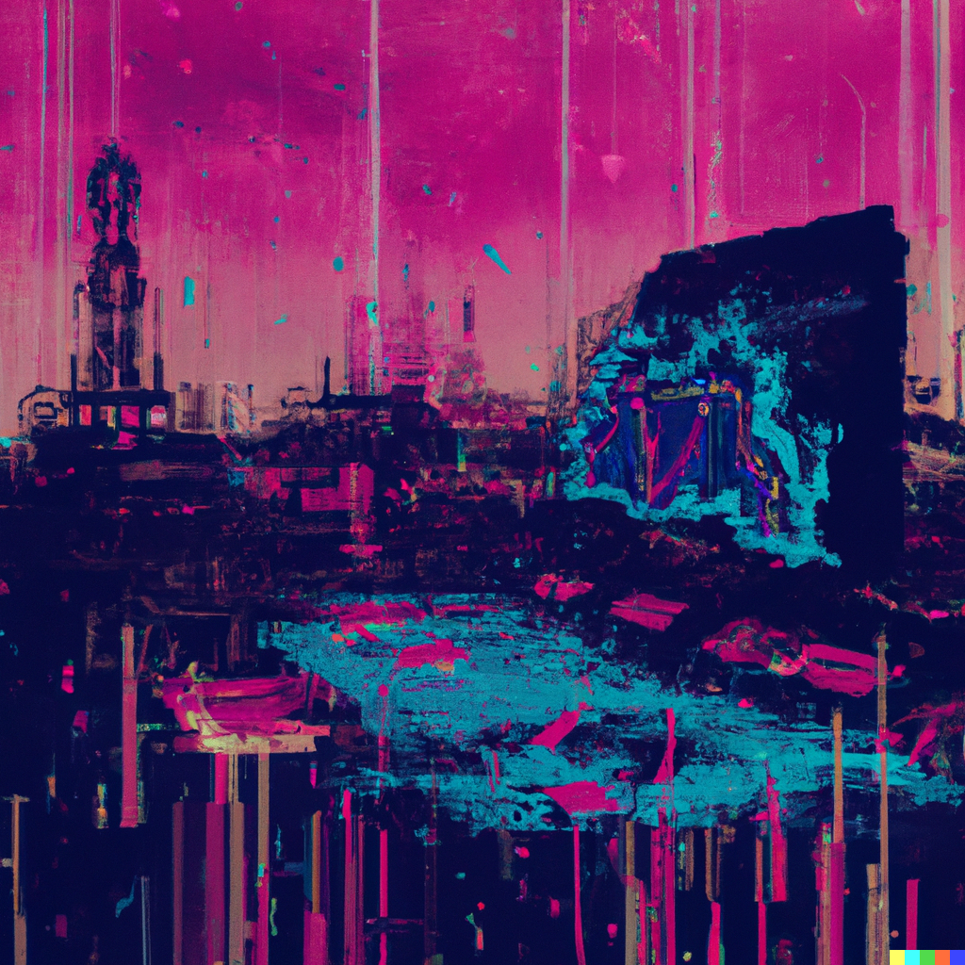
Introduction to OpenAI
Hyland Hackathon

Slide 2
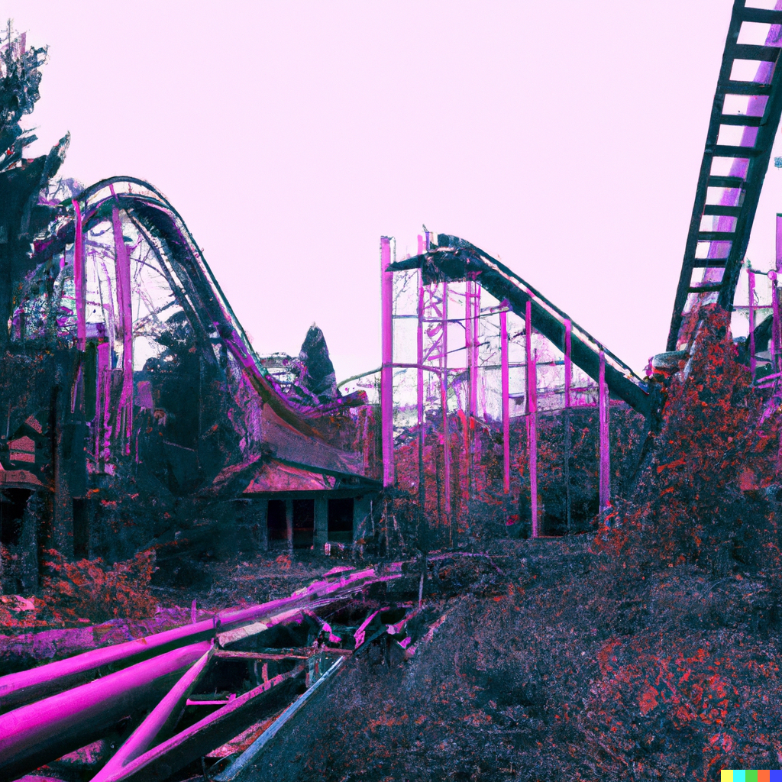
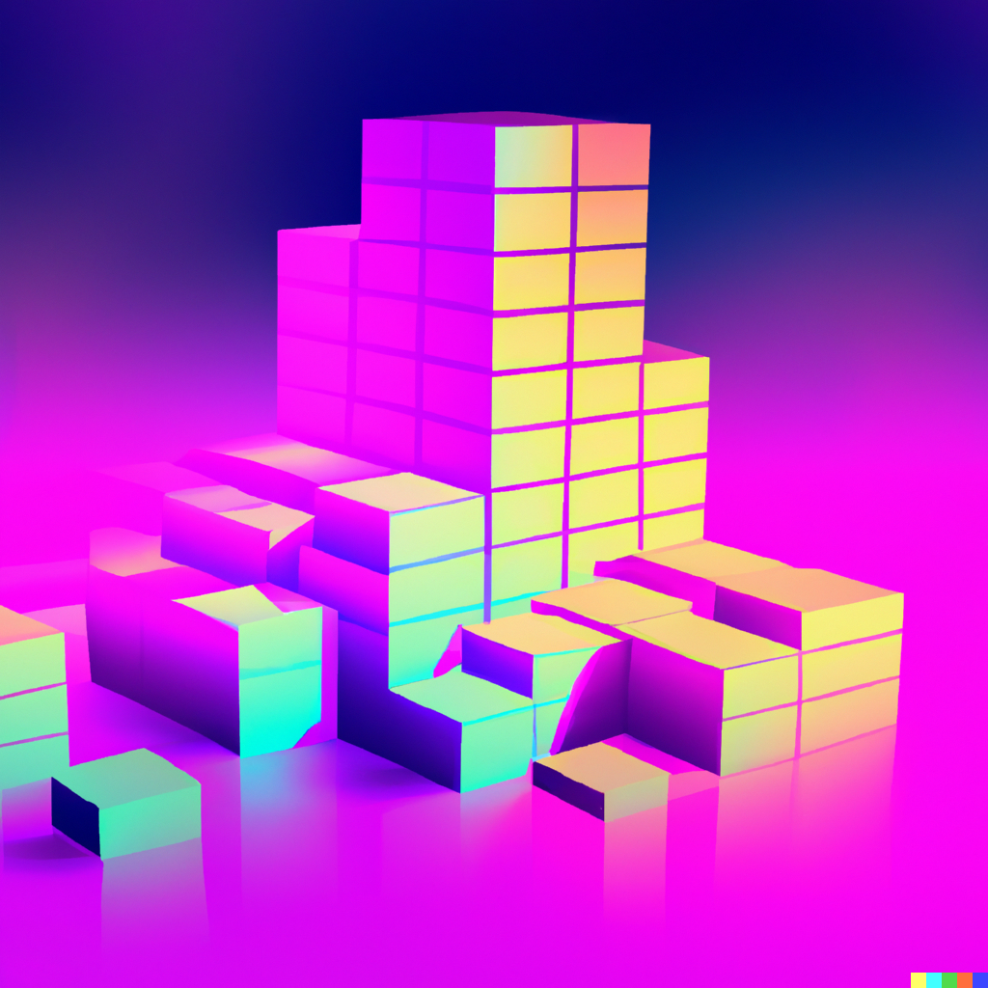
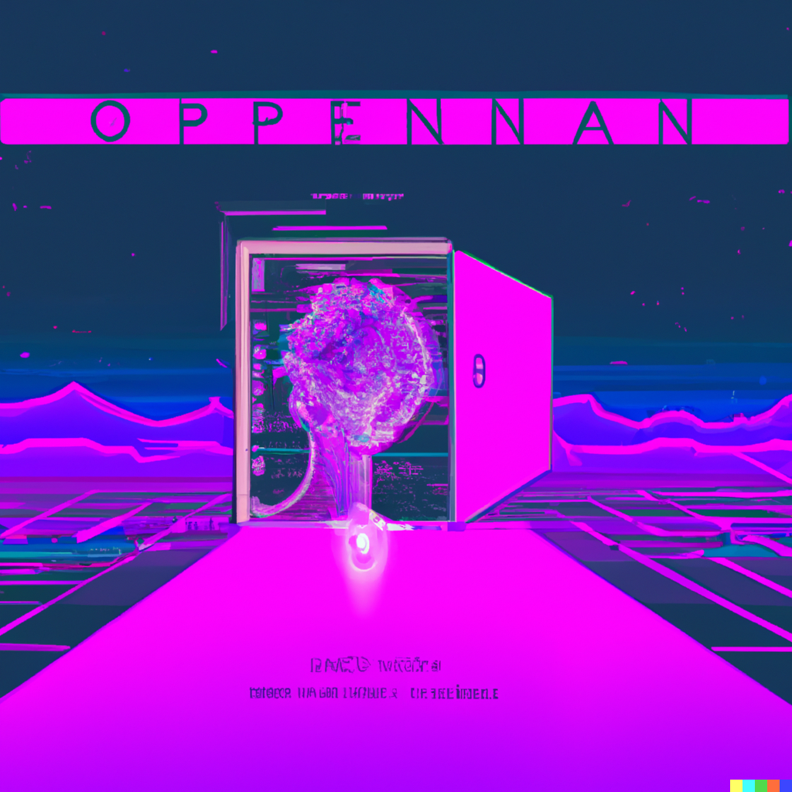
Agenda
🙋‍♂️ | What is OpenAI?
🧠 | Deep Learning
💬 | Natural Language Processing
🎨 | Image Synthesis
💸 | Societal Impacts
📄 | GPT-3 / ChatGPT Demo
❔ | Questions?
😺 | DALL-E 2 Examples

Slide 3
DISCLAIMER Some of this presentation was written by GPT-3.
Notes:
It’s not perfect yet. I’ll be doing a lot of talking off-script to get my points across.
But maybe I didn’t prompt it just right.

Slide 4
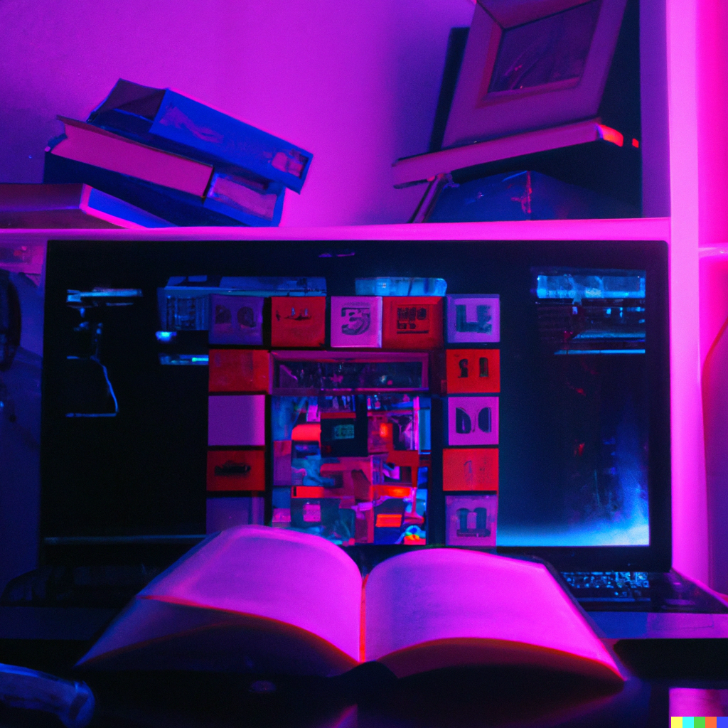
“What is OpenAI?”
AI is a kind of computer software that can perform tasks that would typically require human intelligence.
OpenAI is a research institute that focuses on developing artificial intelligence (AI) technologies
Things like understanding language, recognizing images, and making decisions.
OpenAI is building advanced technologies that can learn and adapt to new situations.
Notes:
AI is a kind of computer software that can perform tasks that would typically require human intelligence
Things like understanding language, recognizing images, and making decisions.
OpenAI is building advanced technologies that can learn and adapt to new situations.

Slide 5
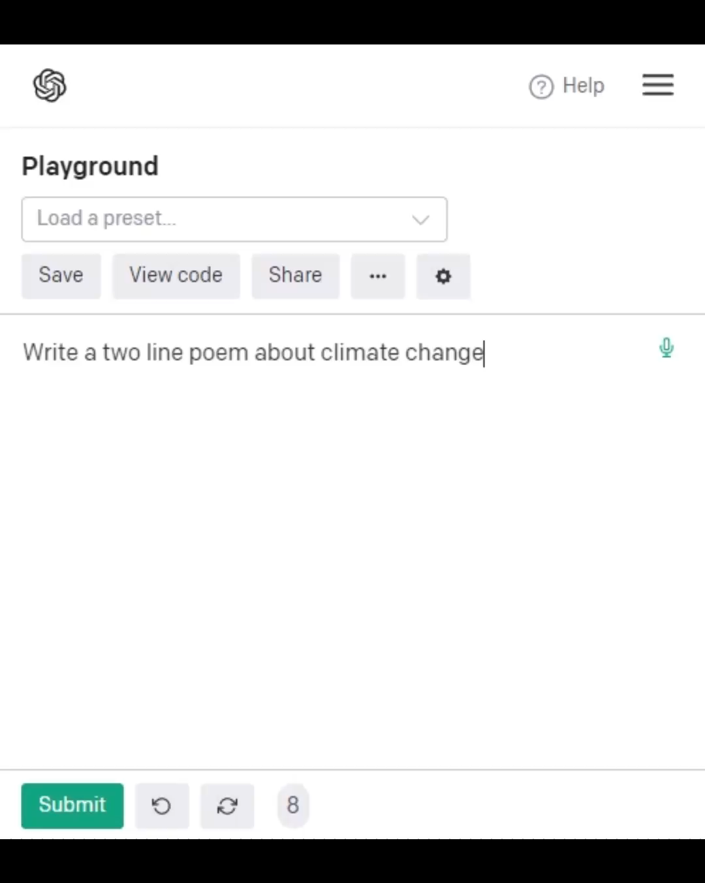
What technologies?
GPT-3
“Generative Pre-trained Transformer 3”
Given some text, it will produce text that continues the prompt
Have it write emails, poetry, your graduation speech, HTML, JavaScript…
Very smart but has the working memory of a goldfish
Notes:
GPT-3 is a LARGE language model that was fed the entire internet as training material.

Slide 6
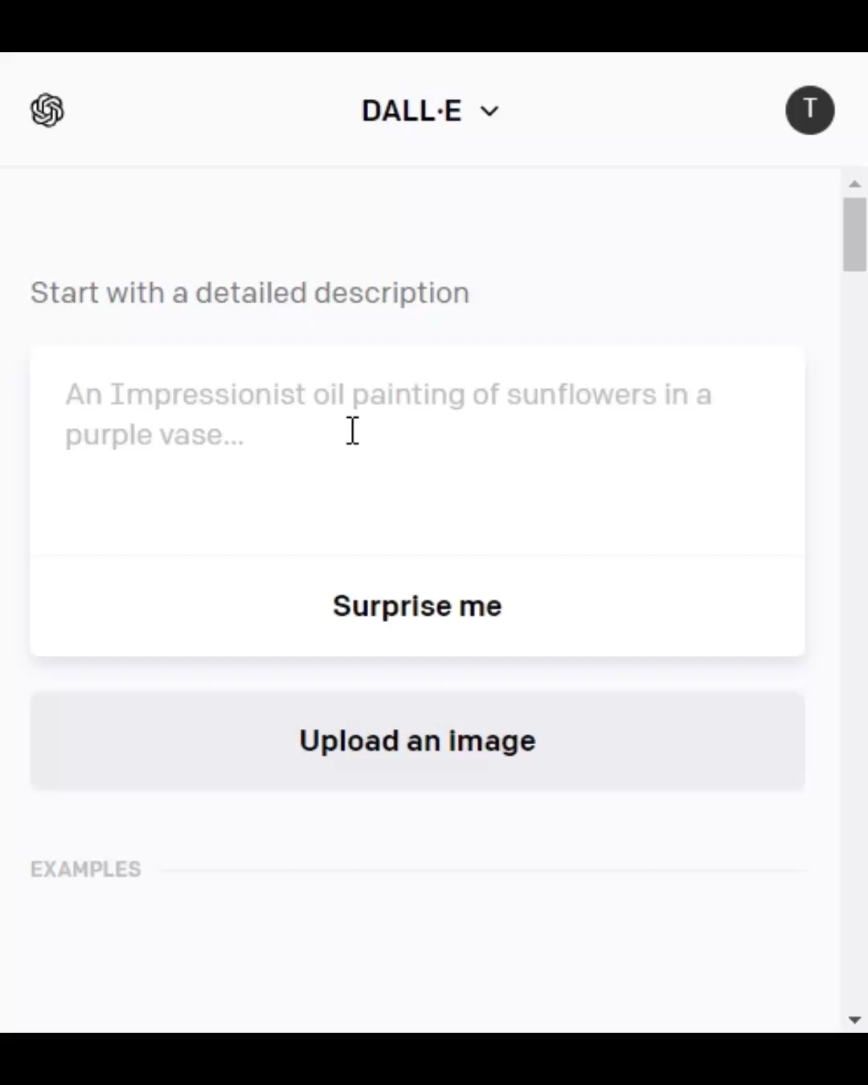
What technologies?
DALL-E 2
Powered by GPT-3
Given some text, it will produce a set of images
You can also give it an image and ask for edits or variations
Notes:
GPT-3 is a LARGE language model that was fed the entire internet as training material.

Slide 7
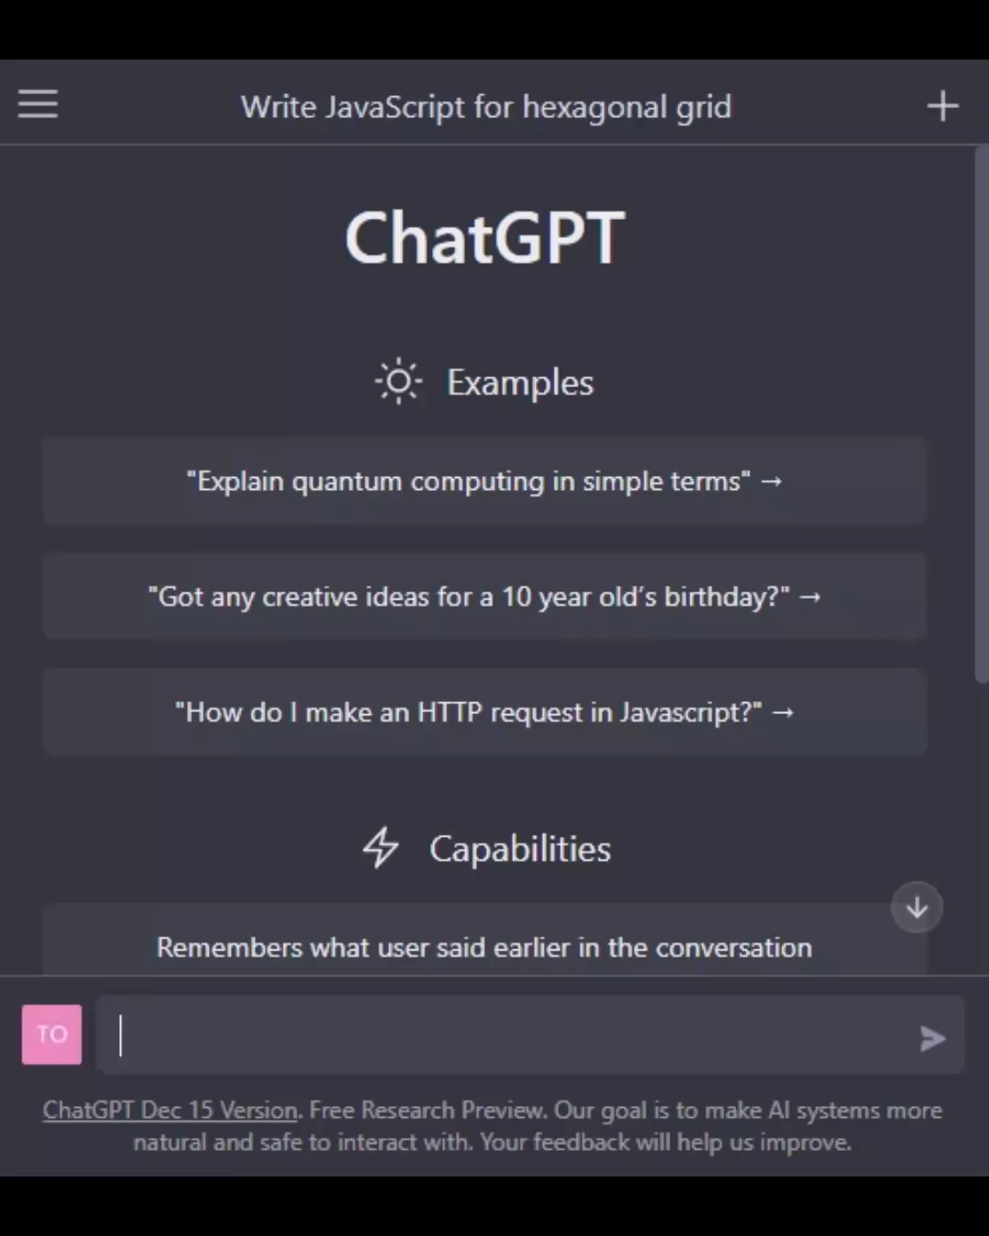
What technologies?
ChatGPT
Powered by GPT-3
Has the capabilities of GPT-3 but is friendly and nice to chat with
Remembers your conversations with it
Notes:
GPT-3 is a LARGE language model that was fed the entire internet as training material.

Slide 8
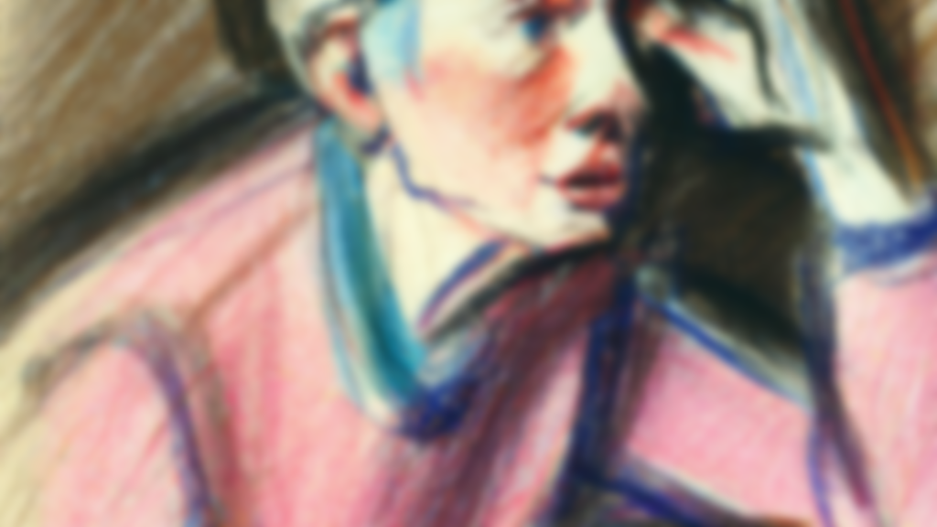
How did they do this?

Slide 9
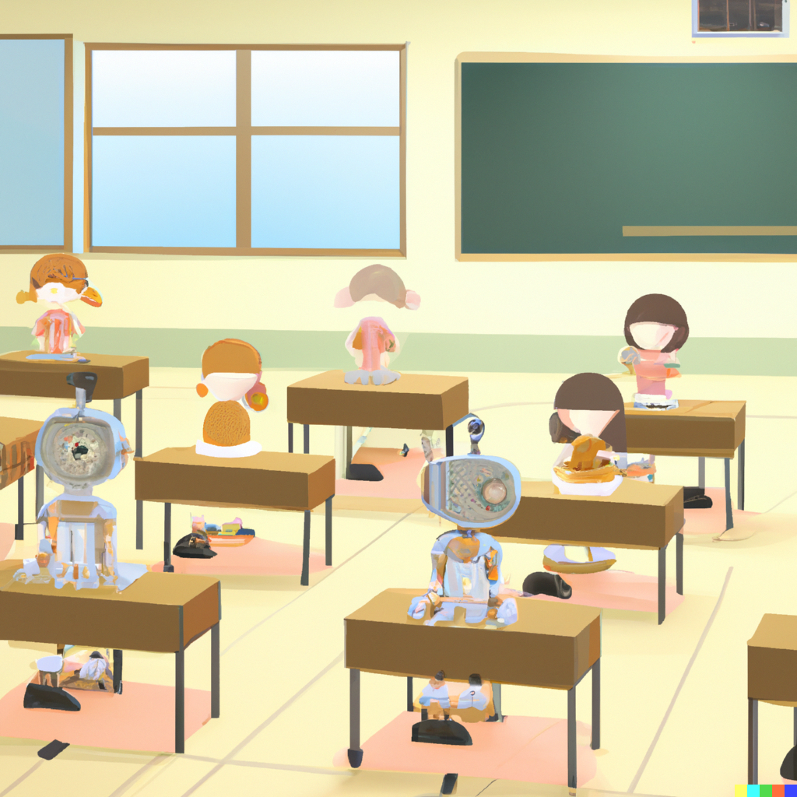
Deep Learning
Training a computer to recognize patterns in data
Notes:
A deep learning algorithm might look at a bunch of pictures of cats and dogs, and then be able to identify which is which in new pictures it hasn't seen before. It does this by finding patterns in the data and using those patterns to make predictions. It's like a computer version of learning from experience.
Well, take that same idea and apply it to a whole bunch of text (the internet, and more). And that’s how we got GPT-3.

Slide 10
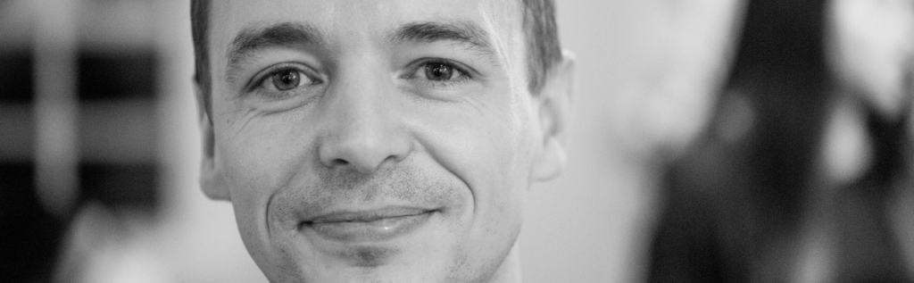
“GPT-3 is basically just an autocompletion algorithm, like in your phone.”
Joscha Bach @Plinz

Slide 11
“It predicts the next words based on the previously seen words, based on the statistics over sequences of words it has seen during its training. But that is in some sense true for our perception as well.”
Joscha Bach @Plinz

Slide 12
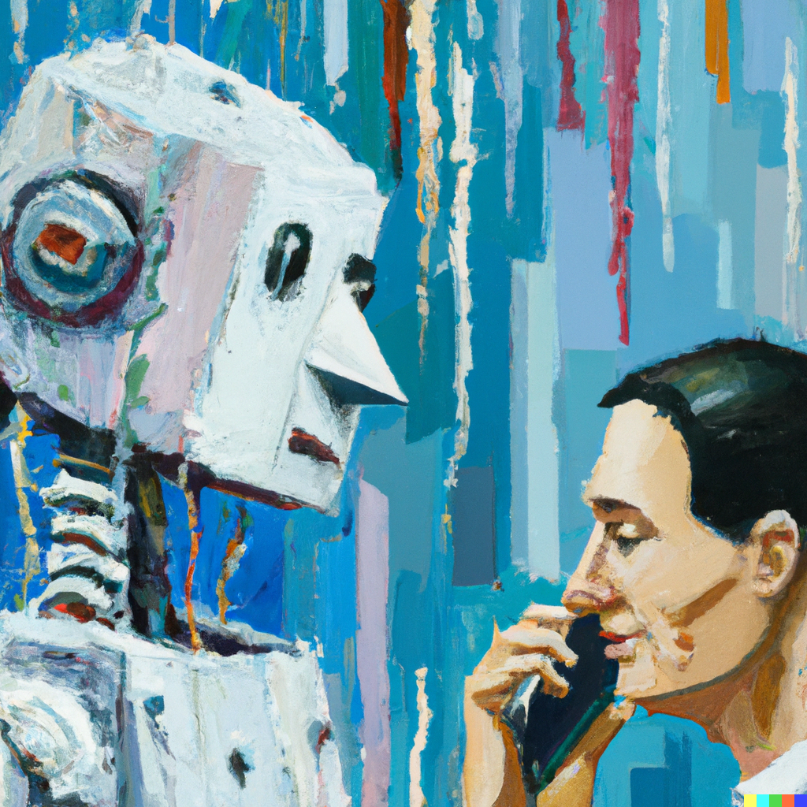
Natural Language Processing
Allowing us to talk to our machines
Notes:
Natural Language Processing (or NLP) is a type of artificial intelligence that helps machines understand and interpret human language.
It involves analyzing text, identifying patterns, and understanding the meaning and context of words.
NLP is used to develop applications such as automated customer service, voice recognition, and text translation.
NLP is necessary because not everyone is a tech guru who knows how to ask the AI the exact right thing.

Slide 13
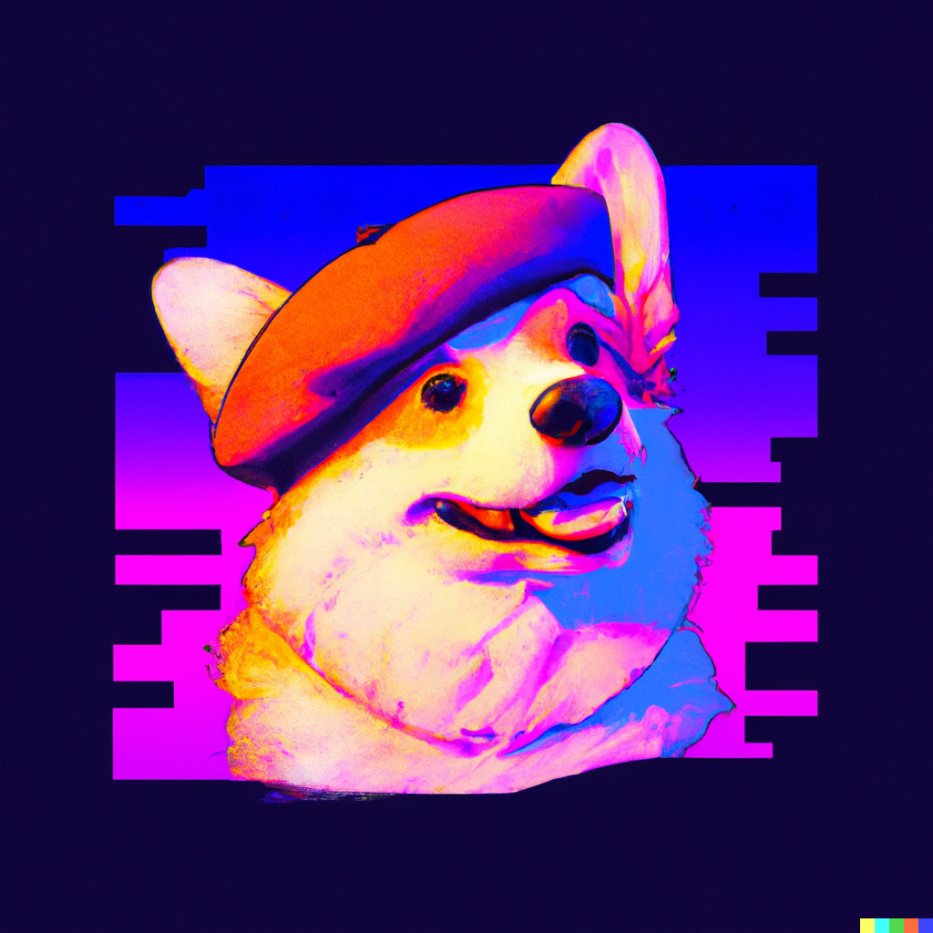
Image Synthesis
Building images from words with DALL-E 2
Notes:
Do we have any artists in the room?
DALL-E 2 is a system that uses GPT-3, a machine learning algorithm, to generate images from text descriptions. It takes a text description as input and uses GPT-3 to generate a corresponding image.
The algorithm works by understanding the text and then using a type of artificial intelligence called Generative Adversarial Networks (GANs) to create a realistic image that matches the text.

Slide 14
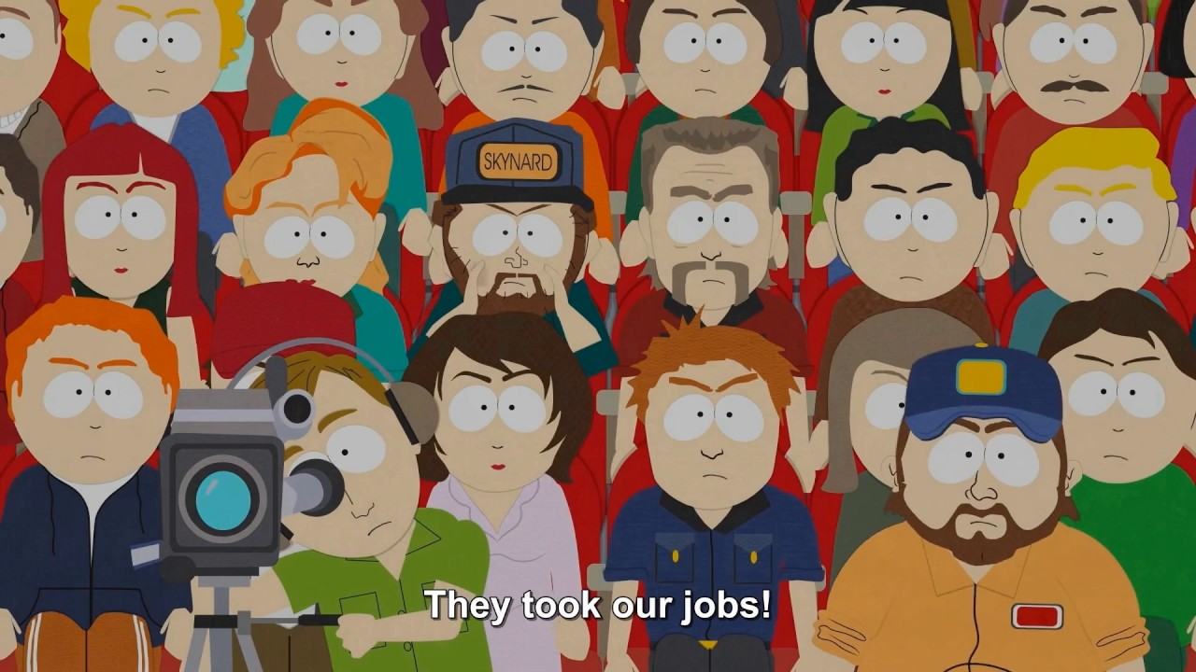
Societal Impacts
What if it takes our jobs?
What will jobs even look like in the future?
How far away is this future?
Notes:
If you’re planning to be an artist, this may already have taken your future job.
If you are planning to be a knowledge worker, start including GPT-3 in your toolbox so you’re not left behind.

Slide 15
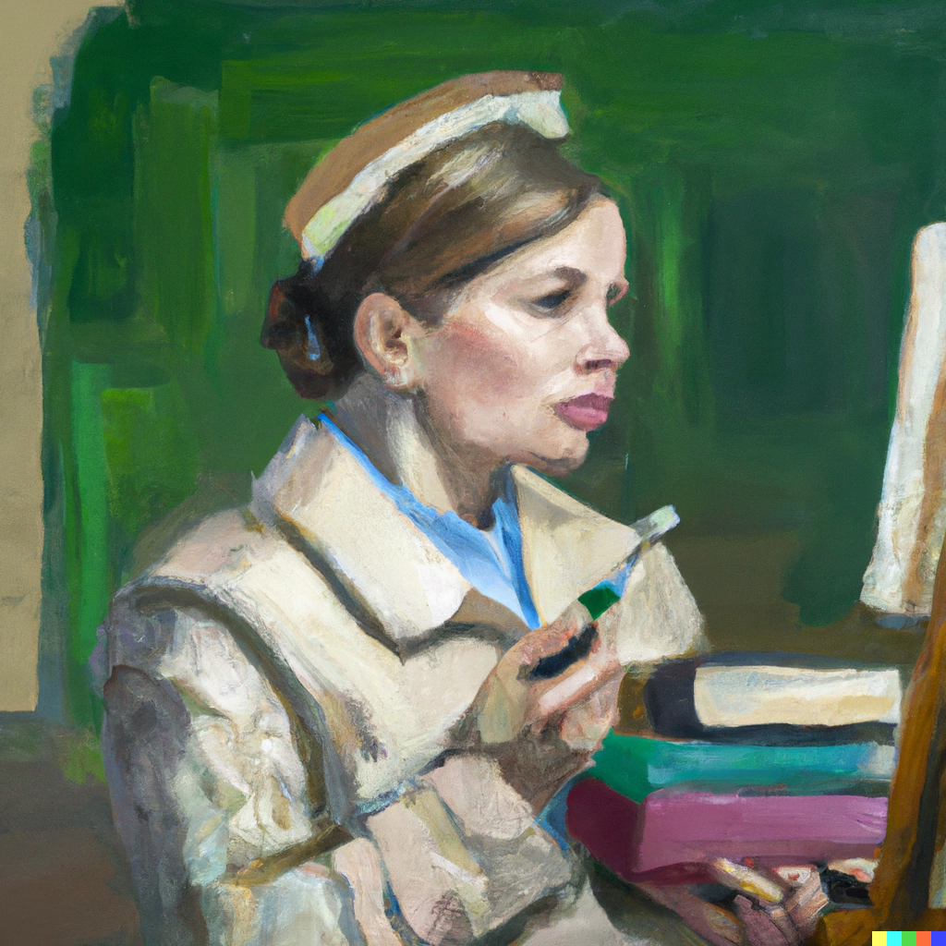
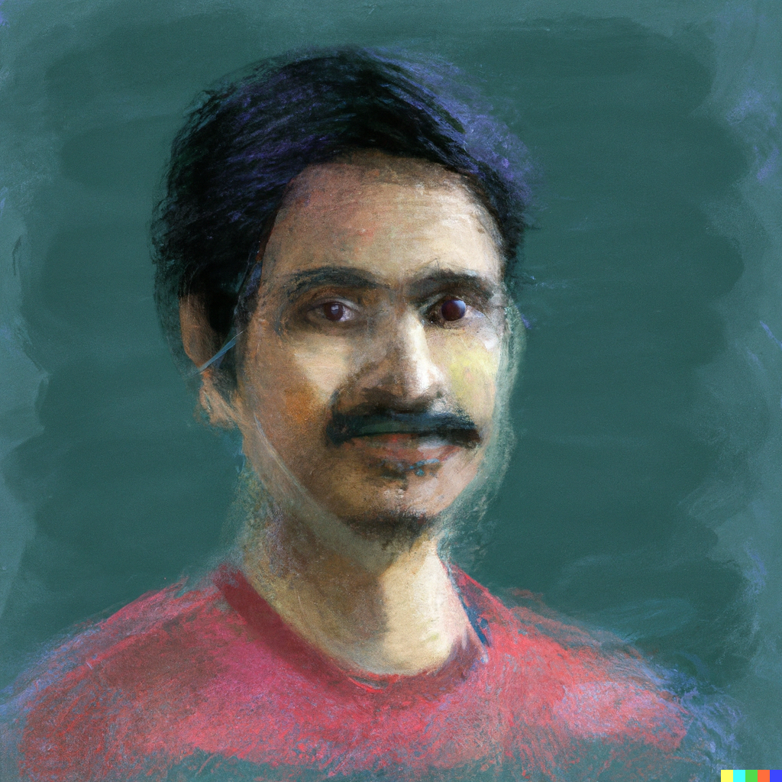
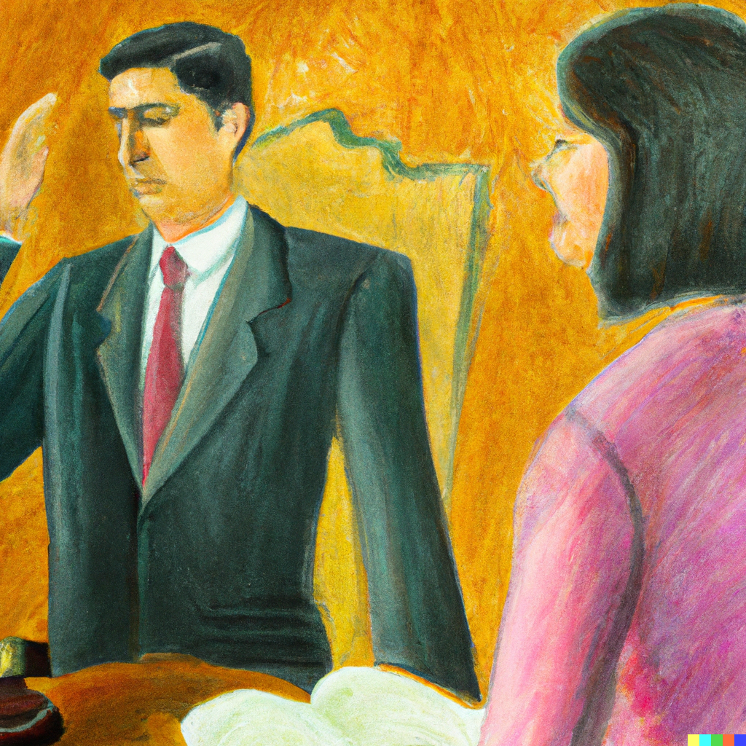
Who are knowledge workers?
Programmers, physicians, pharmacists, architects, engineers, scientists, designers, public accountants, lawyers, editors, academics
Notes:
Knowledge workers are workers whose main capital is knowledge, whose job is to "think for a living.”
What can we do to prepare ourselves?
- Create an account with OpenAI. Start playing with it.
- Ask ChatGPT hard questions about your code.
- Create an app that uses the APIs in some way. If you don’t know where to start, just ask GPT-3 for the code, and it will get you most of the way there.

Slide 16
GPT-3 / ChatGPT Demo (prerecorded)
Notes:
Play the “gpt-3_website_demo.mp4” demo video, located in the Assets folder.

Slide 17
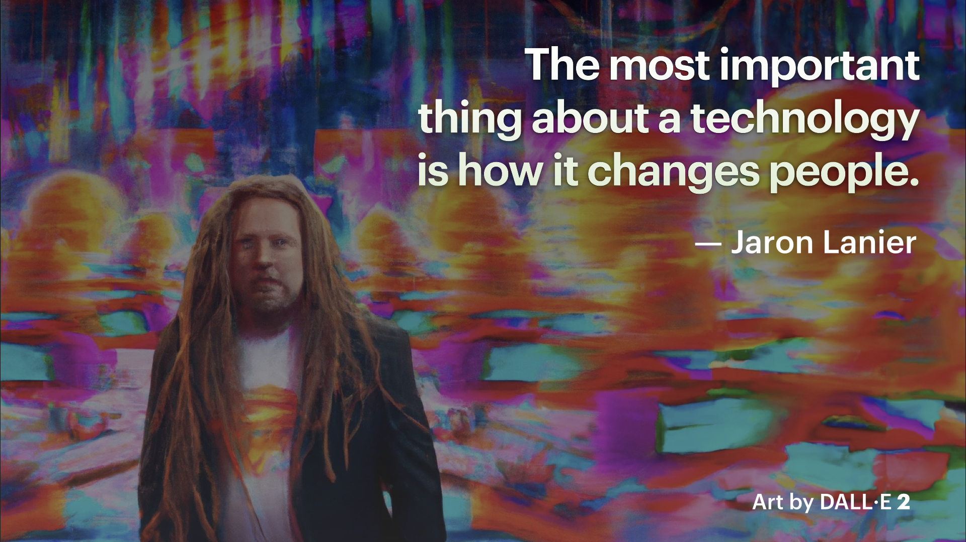
Notes:
Something to think about.

Slide 18
Questions? Want to chat about this?
Notes:
Before we jump into a live demo, please take a look at some other images I had DALL-E create!

Slide 19
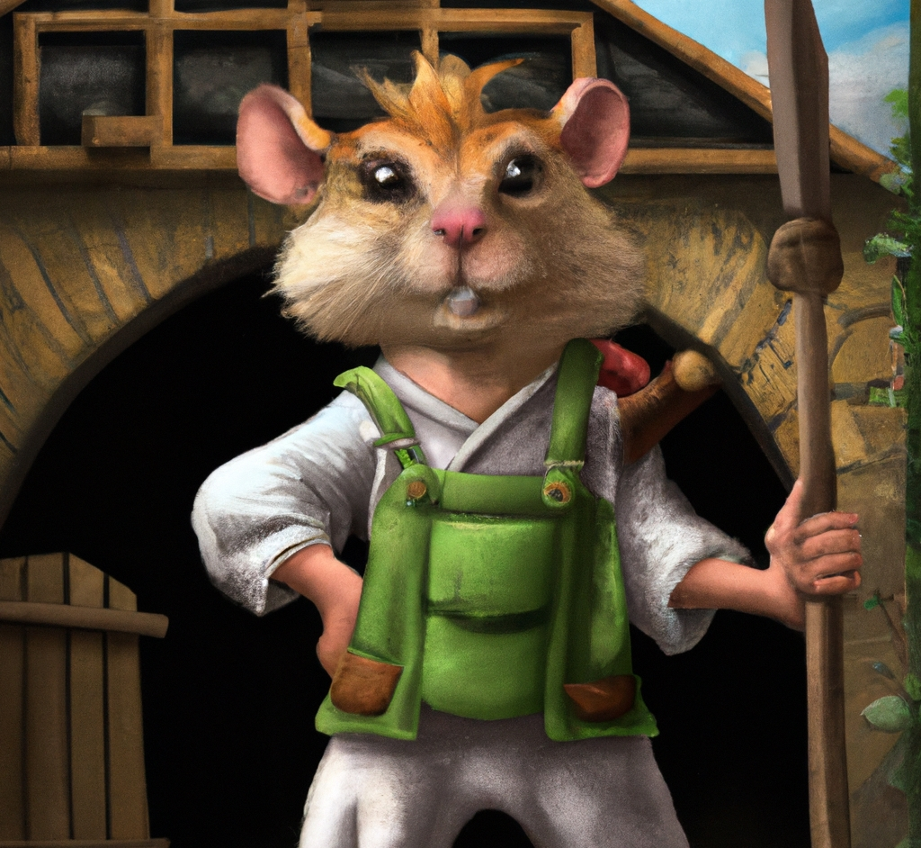
“Anthropomorphic gerbil in overalls holds a spear and stands in front of his farmhouse, digital art”
DALL·E 2

Slide 20
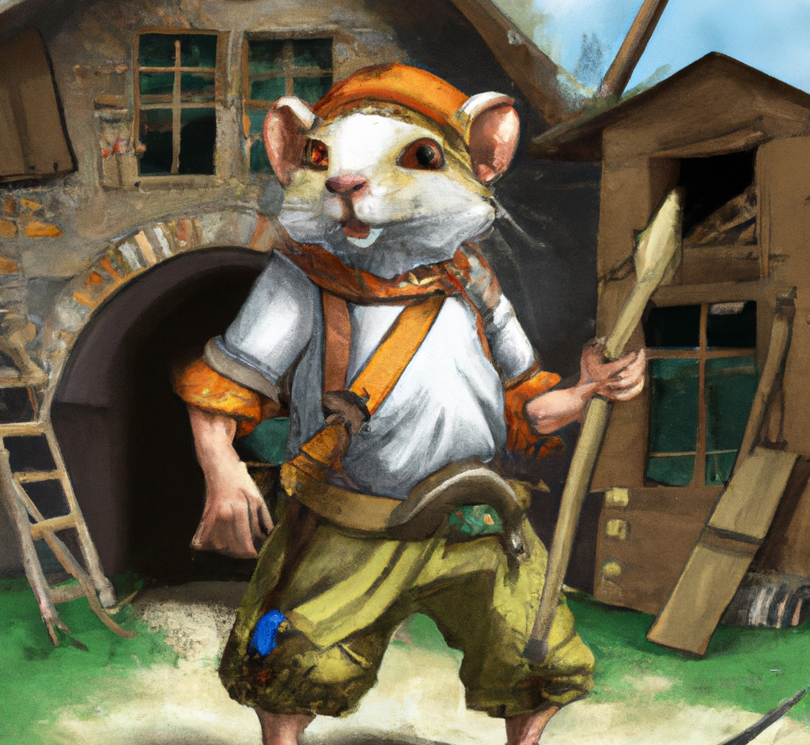
“Anthropomorphic gerbil in overalls holds a spear and stands in front of his farmhouse, digital art”
DALL·E 2

Slide 21
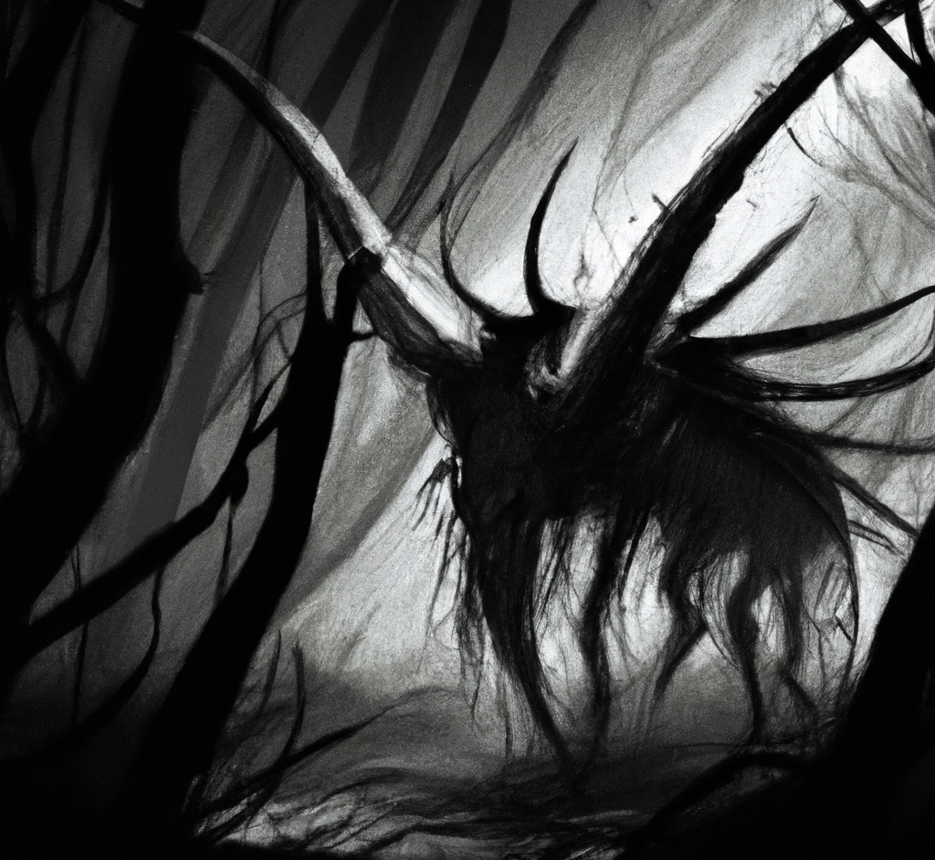
“Shadow creature, digital art”
DALL·E 2

Slide 22
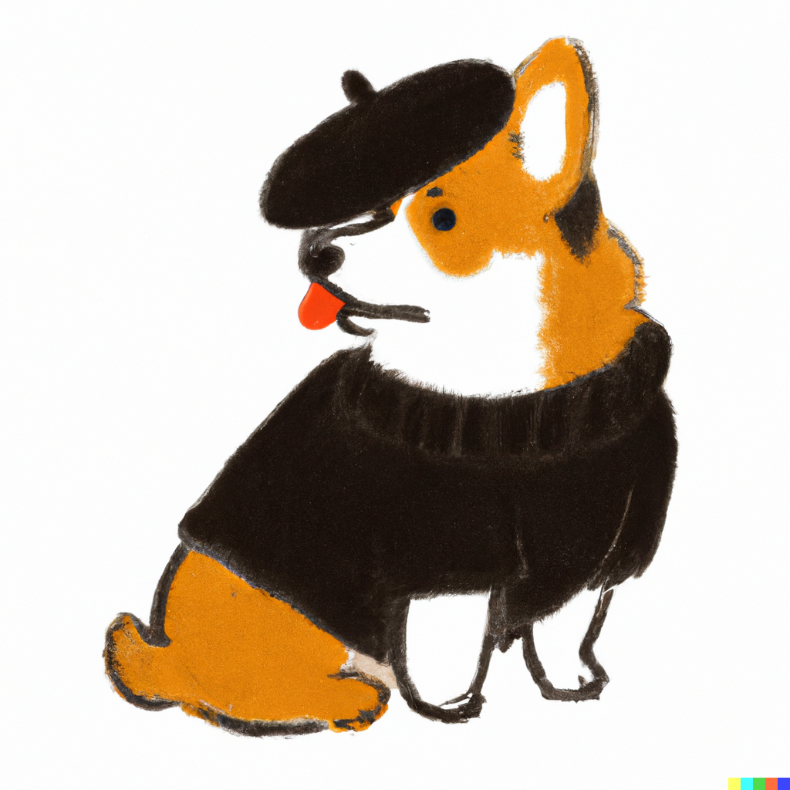
“A Welsh Corgi wearing a beret and black turtleneck”
DALL·E 2

Slide 23
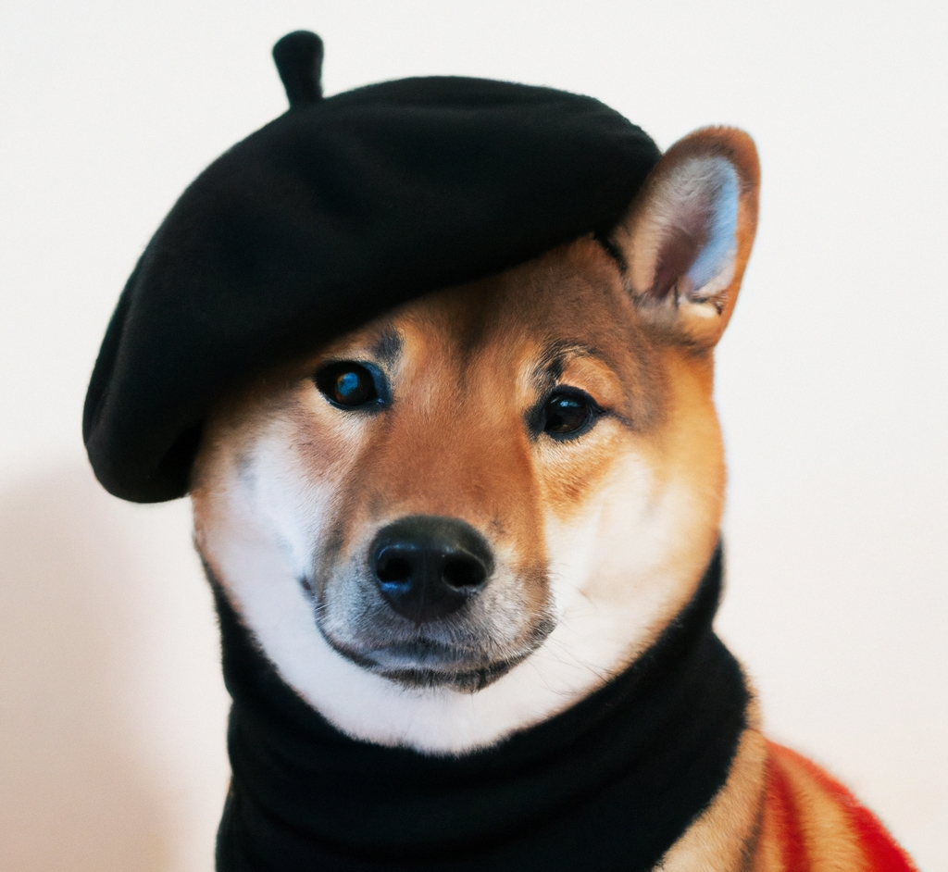
“A Shiba Inu dog wearing a beret and black turtleneck”
DALL·E 2

Slide 24
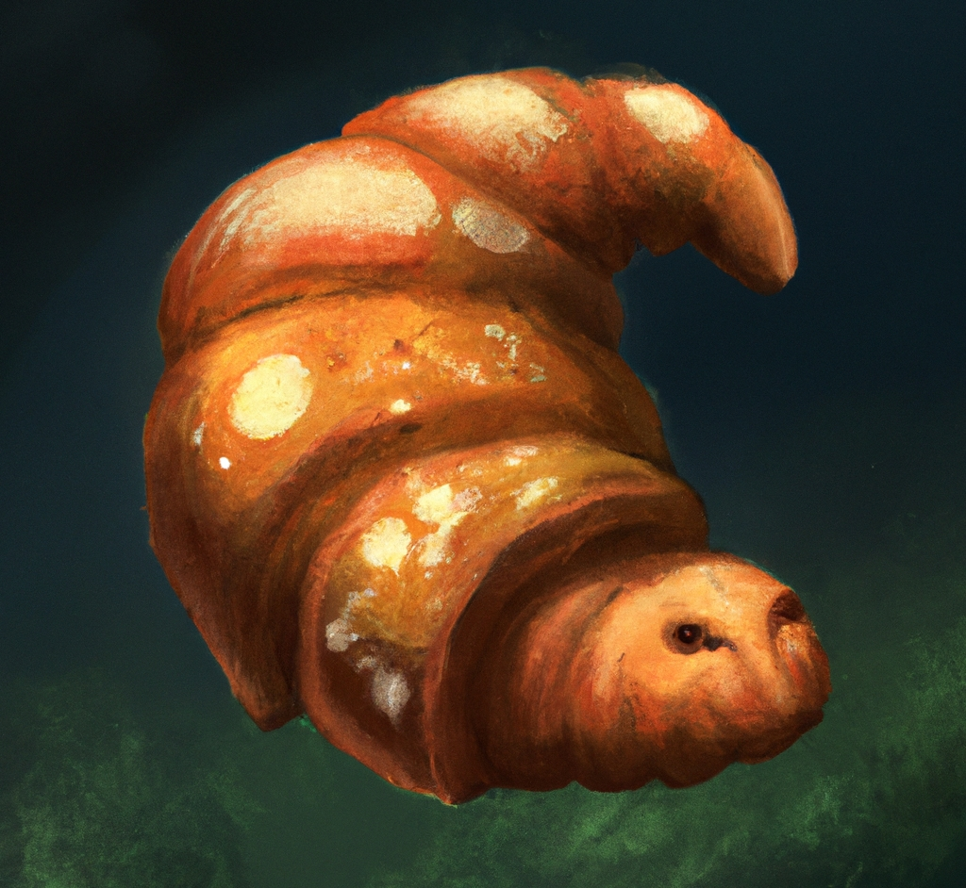
“Tardigrade croissant, digital art”
DALL·E 2

Slide 25
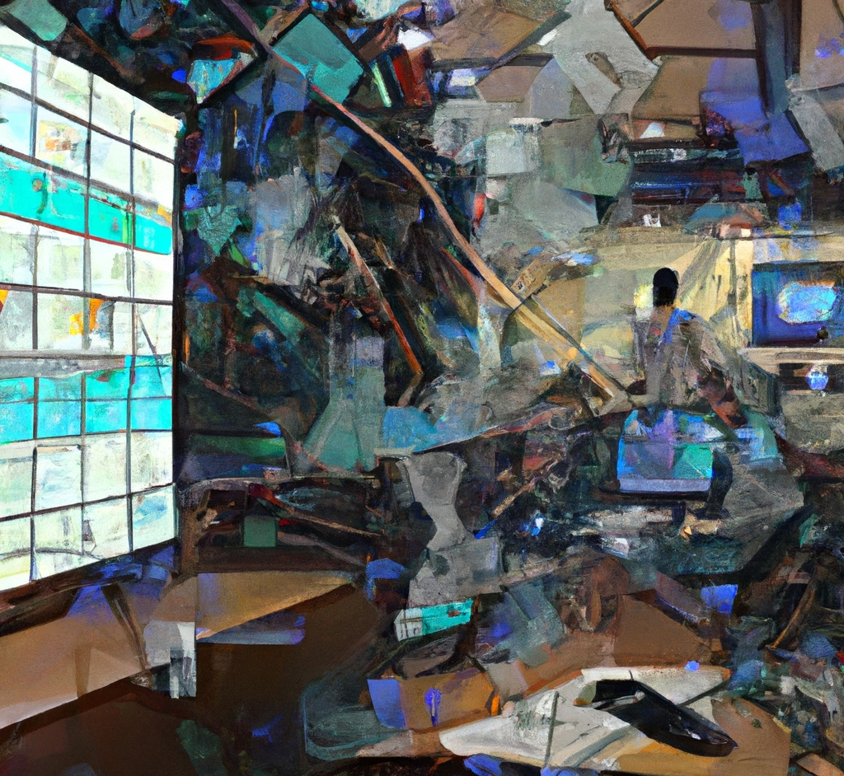
“An impressionist painting of a workplace with a futuristic augmented reality interface covering every surface”
DALL·E 2

Slide 26
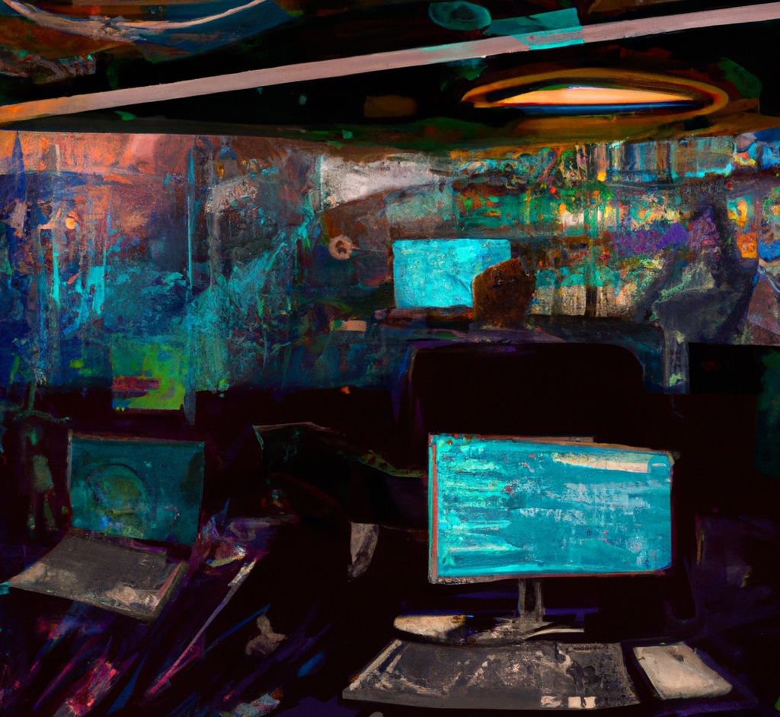
“An impressionist painting of a workplace with a futuristic augmented reality interface covering every surface”
DALL·E 2

Slide 27
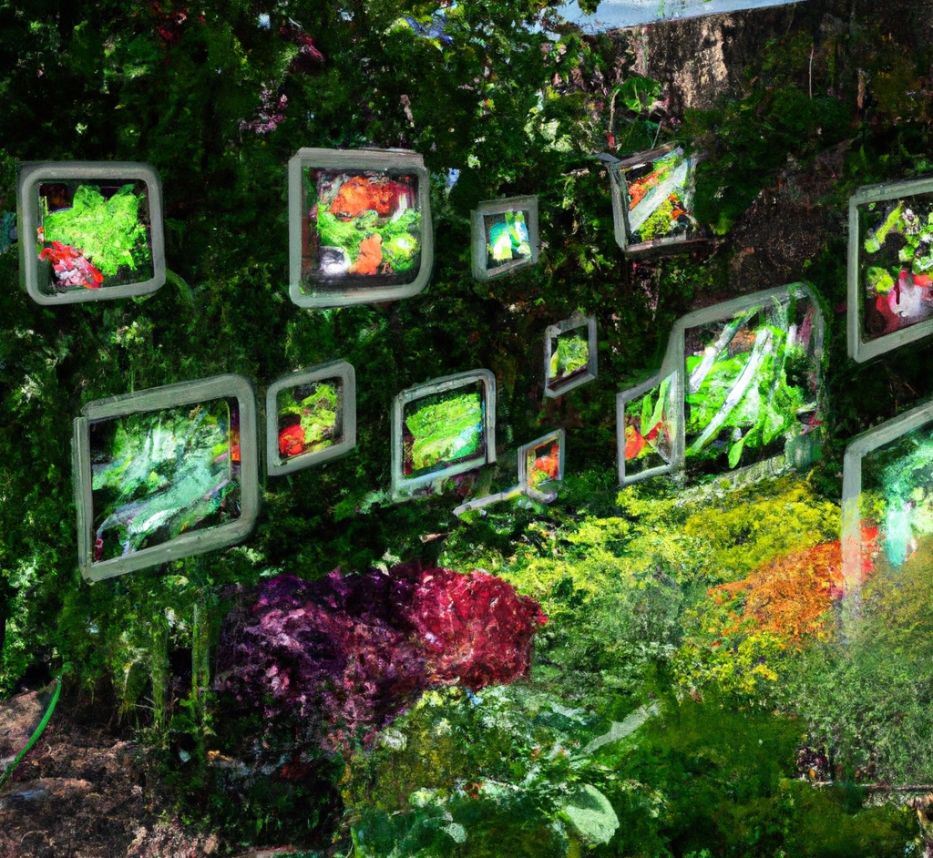
“A garden with a variety of vegetables. The plants are decorated with minority report style augmented reality holograms.”
DALL·E 2

Slide 28
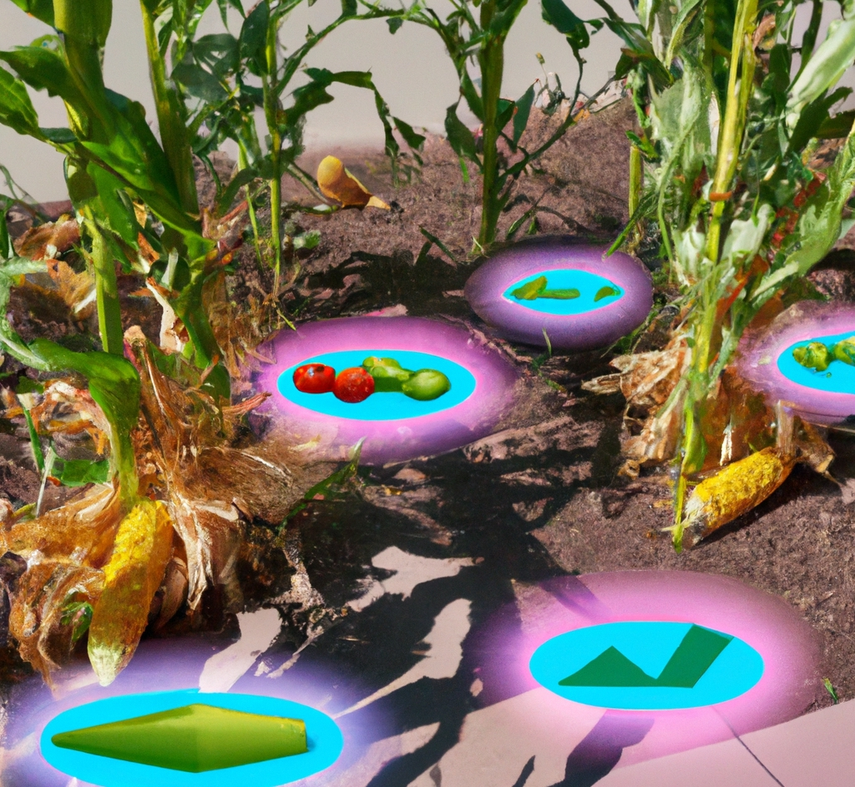
“A garden with corn and tomatoes. The plants are decorated with augmented reality holograms showing soil moisture and mineral levels.”
DALL·E 2

Slide 29
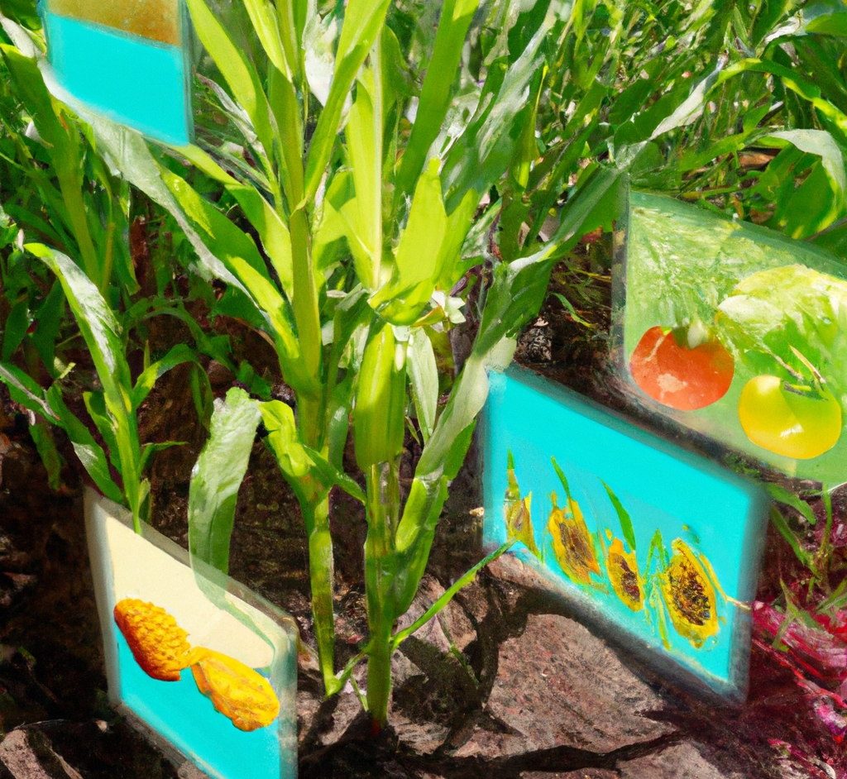
“A garden with corn and tomatoes. The plants are decorated with augmented reality holograms showing soil moisture and mineral levels.”
DALL·E 2

Slide 30
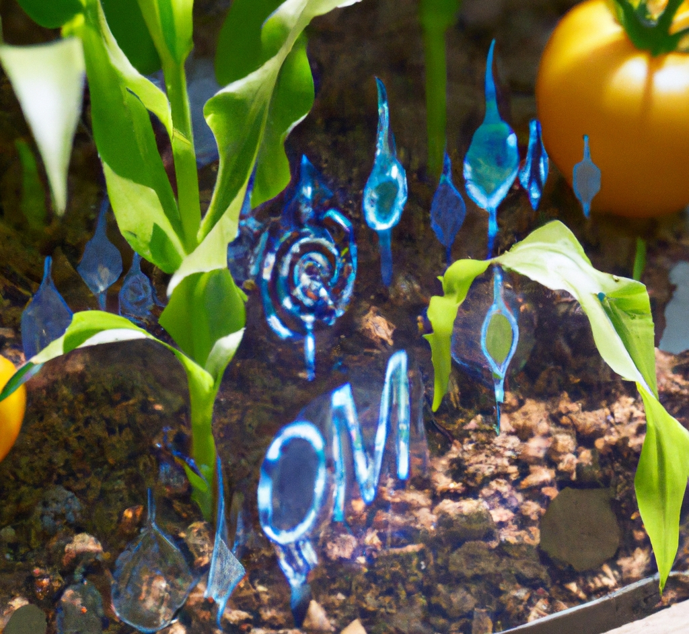
“A close up photo of a garden with corn and tomatoes. The plants are decorated with futuristic Iron Man style holograms showing soil moisture and mineral levels.”
DALL·E 2

Slide 31
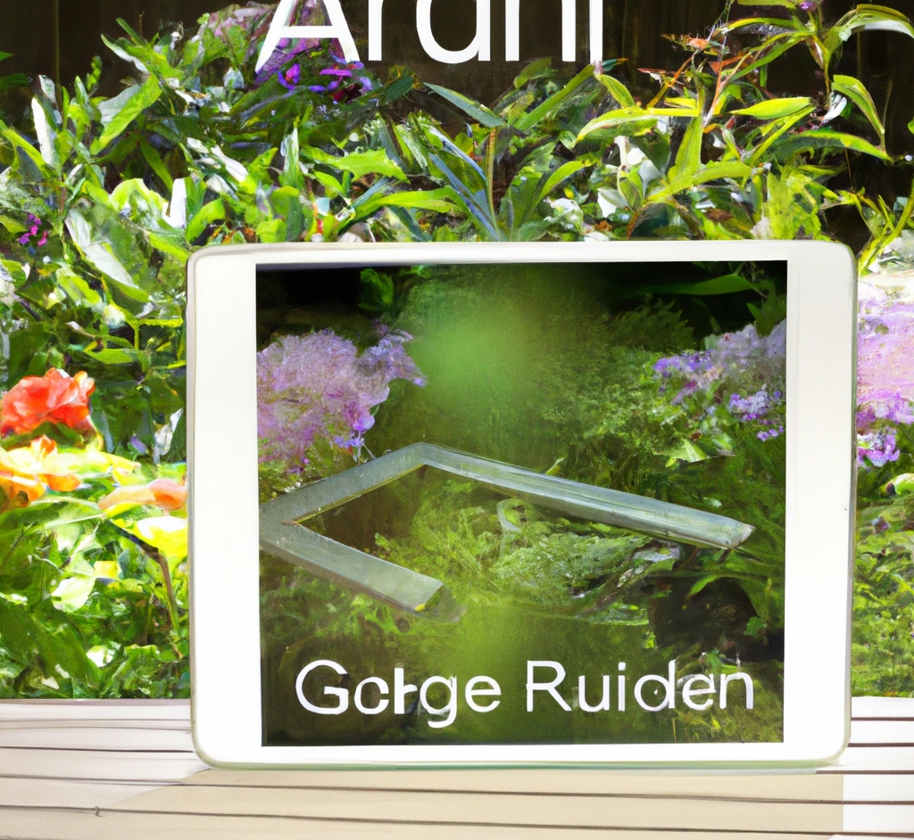
“augmented reality garden app for your ipad”
DALL·E 2

Slide 32
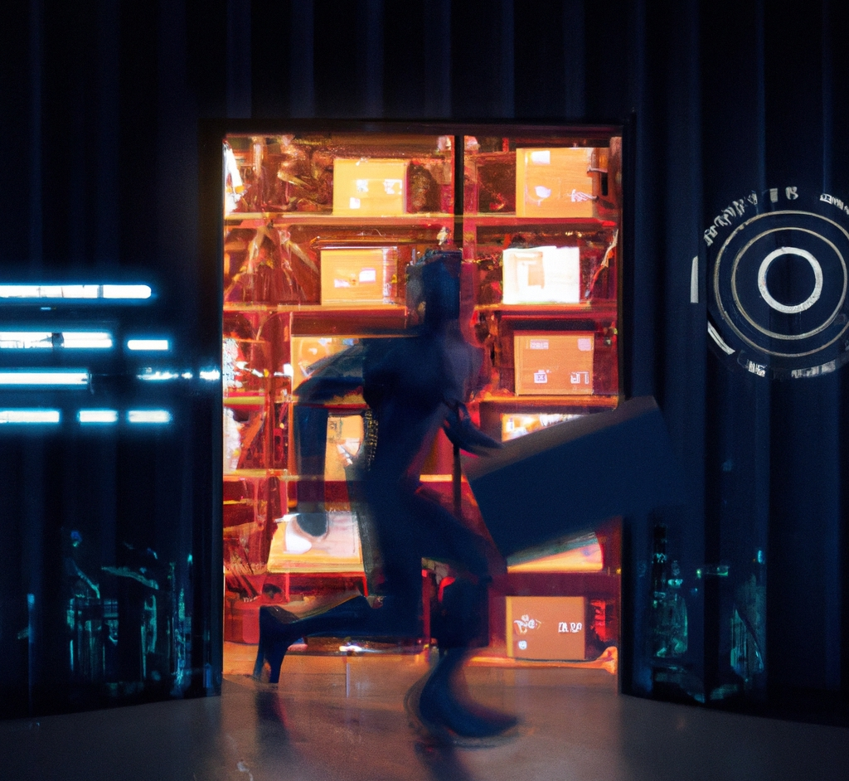
“A warehouse with futuristic Iron Man style shipment data holograms”
DALL·E 2

Slide 33
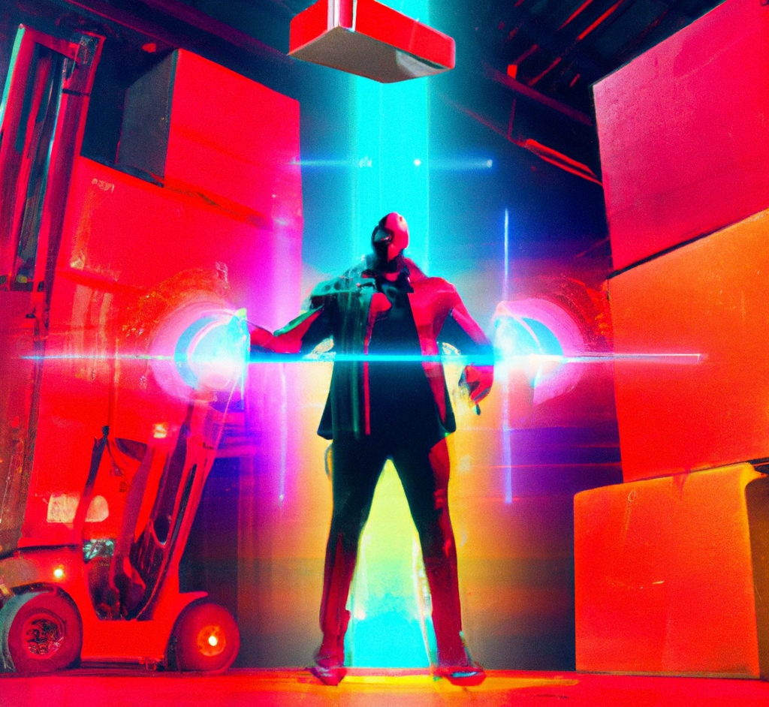
“A warehouse with futuristic Iron Man style shipment data holograms”
DALL·E 2

Slide 34
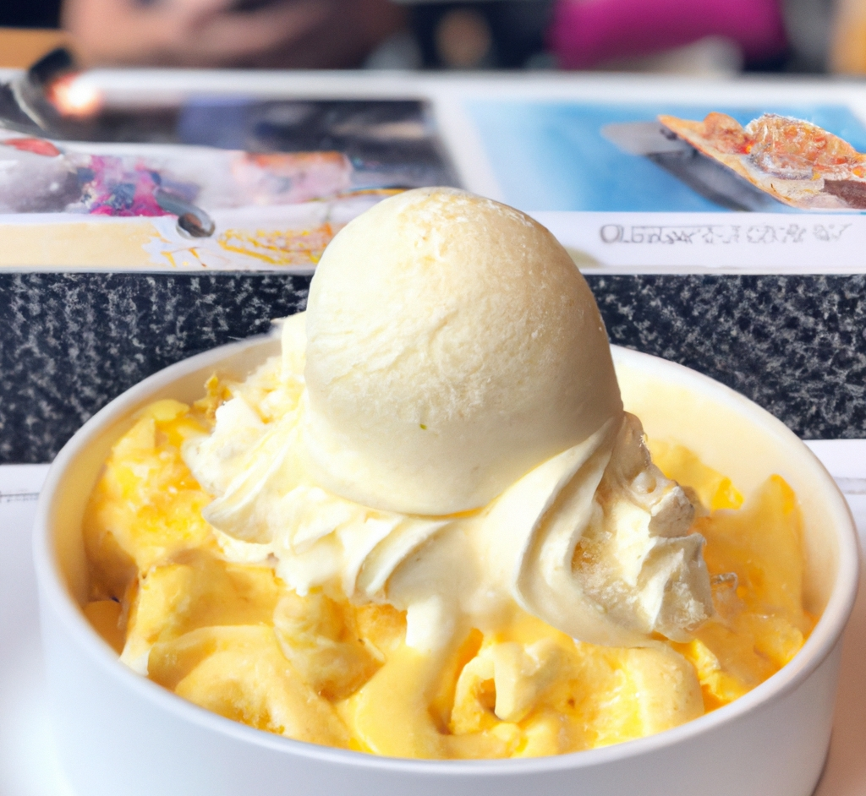
“macaroni and cheese ice cream”
DALL·E 2

Slide 35
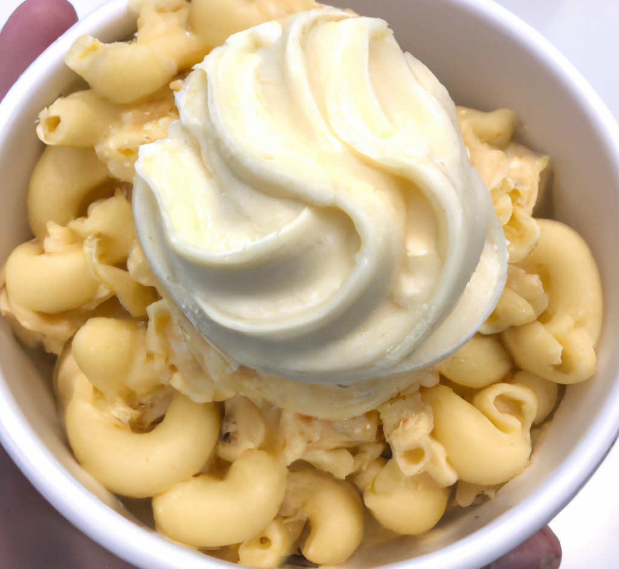
“macaroni and cheese ice cream”
DALL·E 2

Slide 36
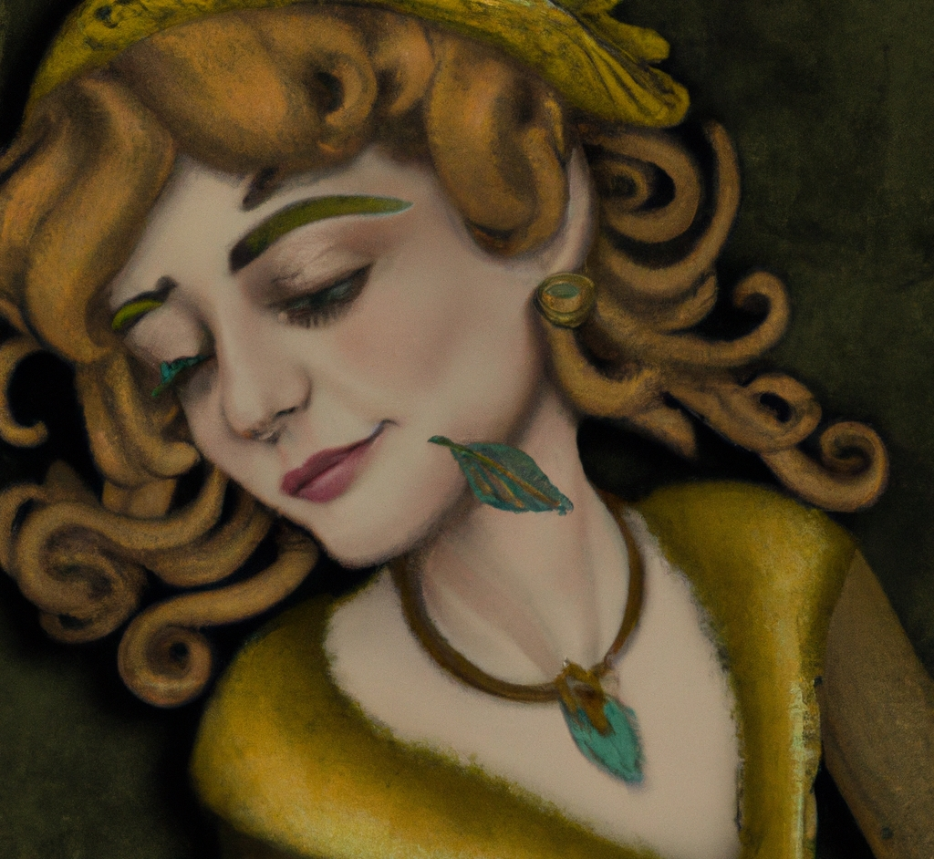
“dall-e self portrait, by dall-e”
DALL·E 2

Slide 37
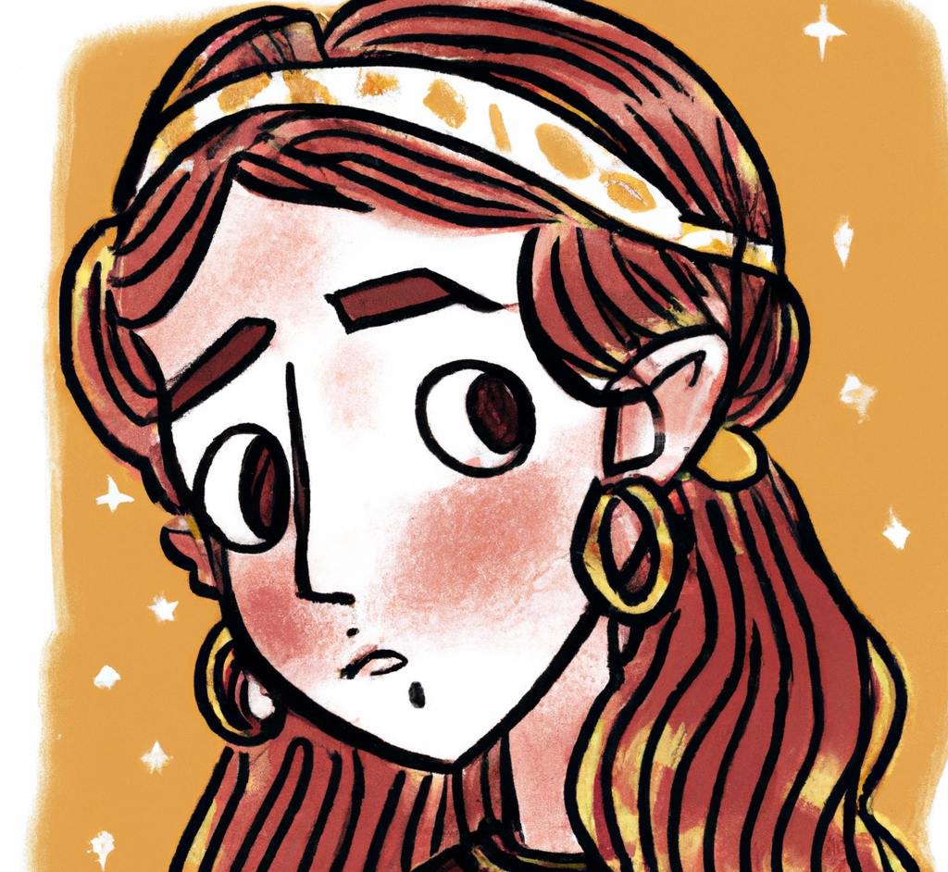
“dall-e self portrait, by dall-e”
DALL·E 2

Slide 38
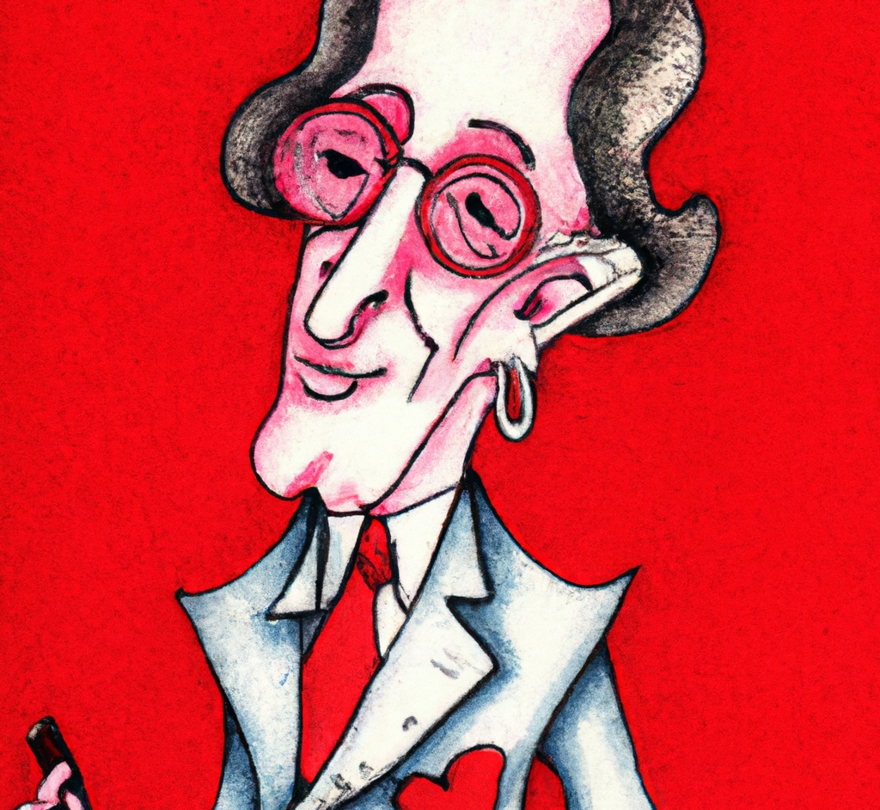
“dall-e self portrait, by dall-e”
DALL·E 2

Slide 39
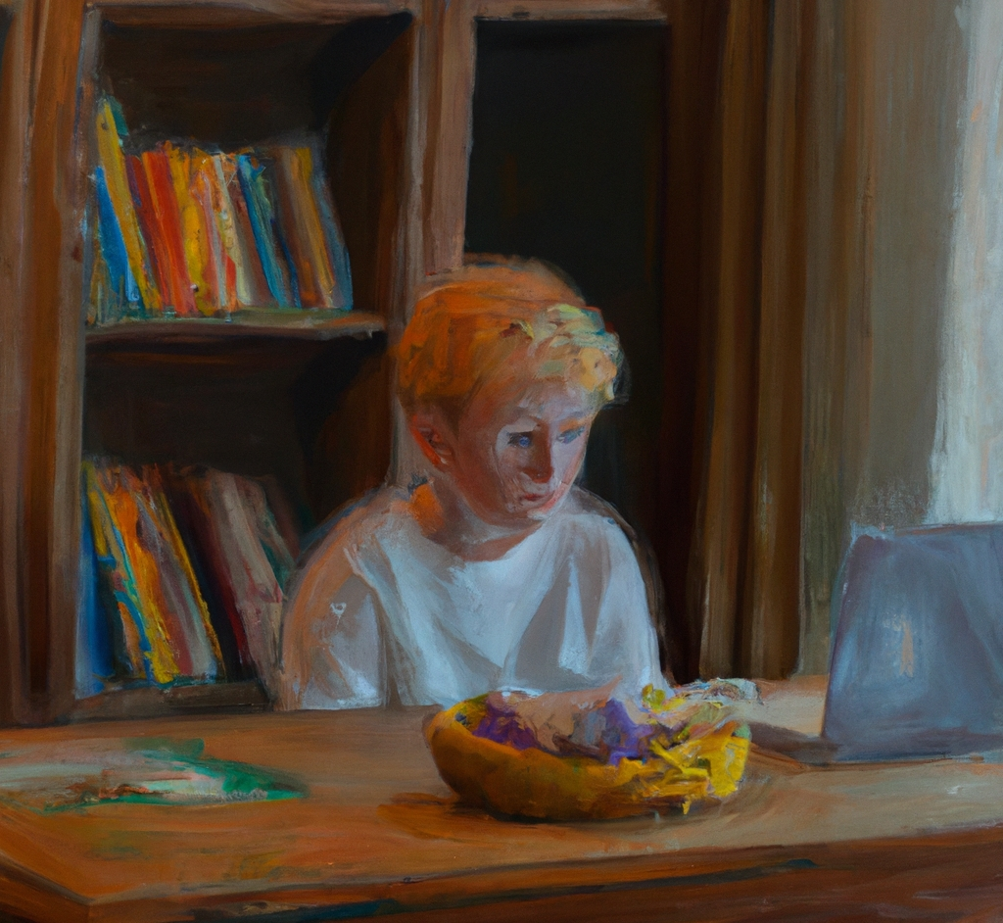
“A boy with blond hair sits on a wooden dining room table. There is a laptop and some fruit on the table. Oil painting.”
DALL·E 2

Slide 40
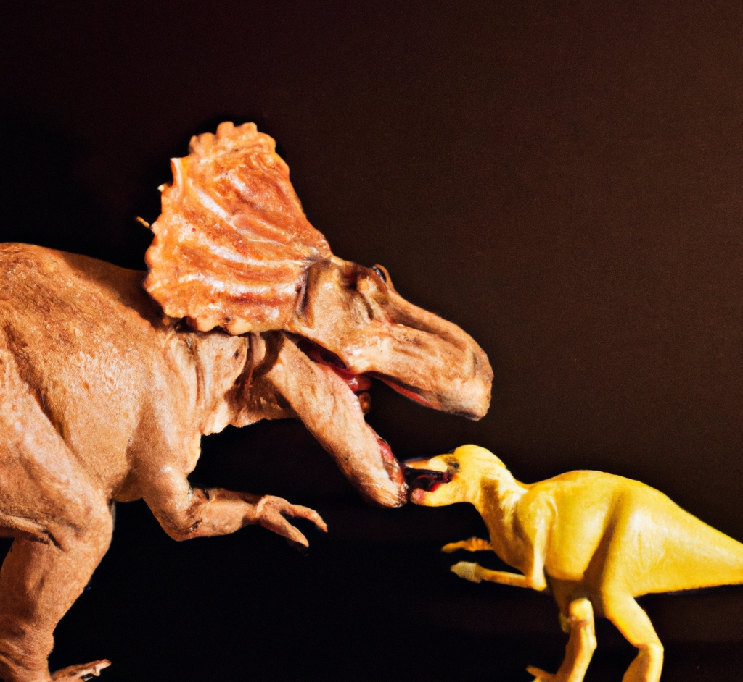
“A dinosaur eating a dinosaur”
DALL·E 2

Slide 41
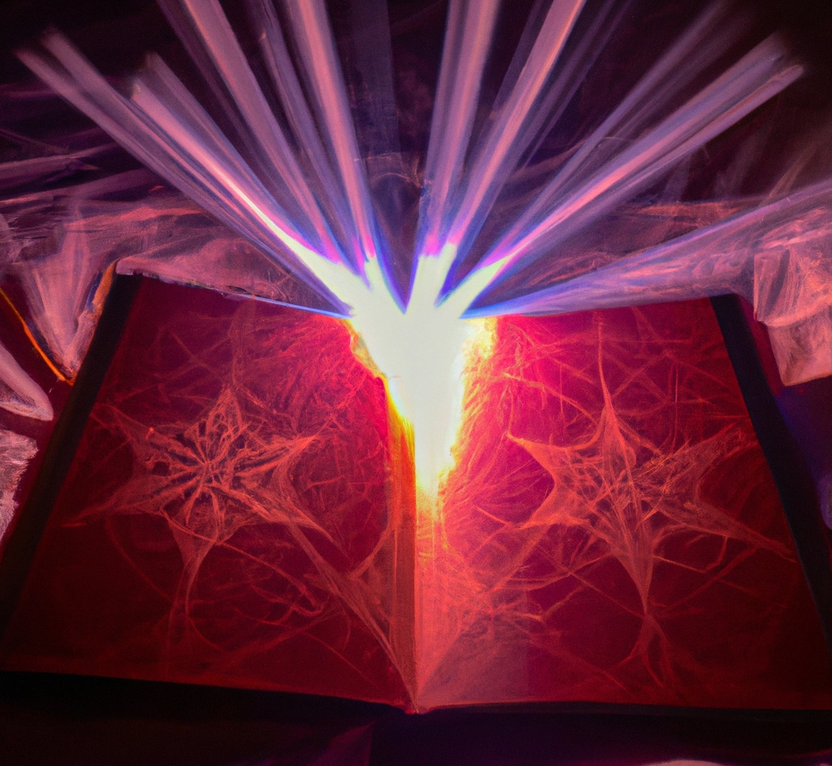
“A book with dark magic that makes things real”
DALL·E 2

Slide 42

“An octopus with wings, flying in the sunshine, and the octopus has eaten the moon.”
DALL·E 2

Slide 43
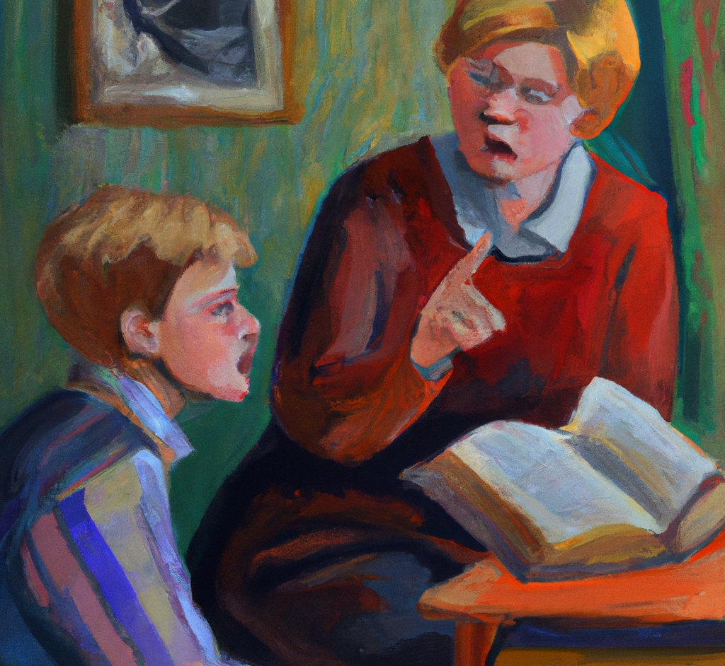
“A teacher scolds a student for noticing a flaw in the book they are reading, oil painting”
DALL·E 2

Slide 44
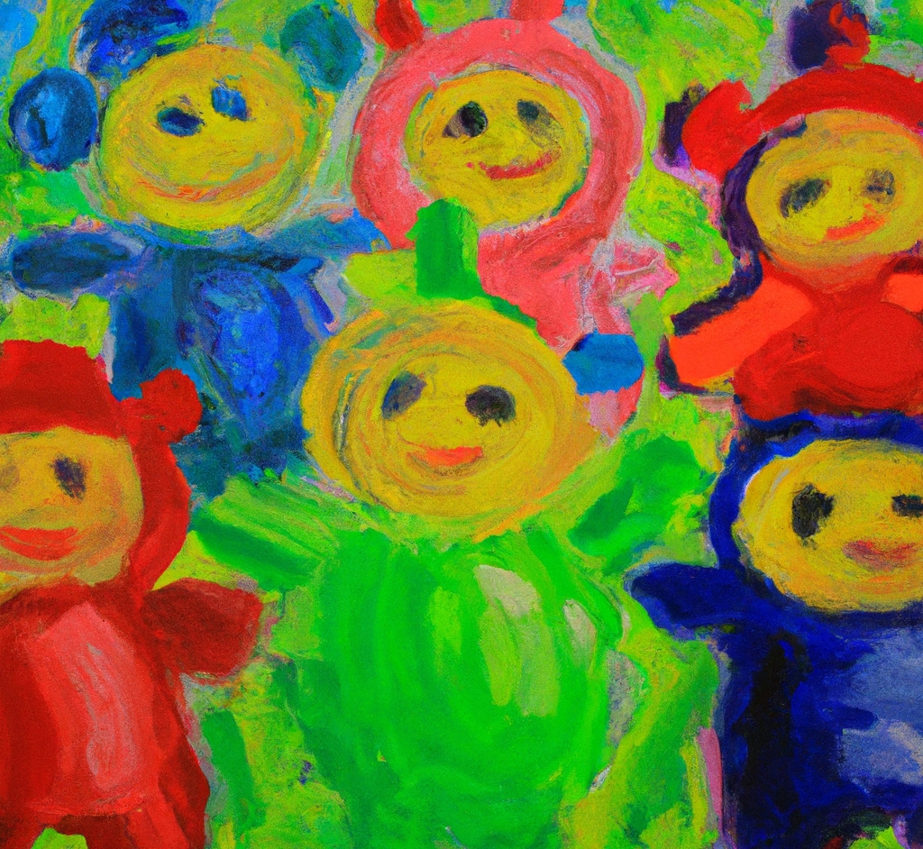
“An impressionist painting of teletubbies”
DALL·E 2

Slide 45
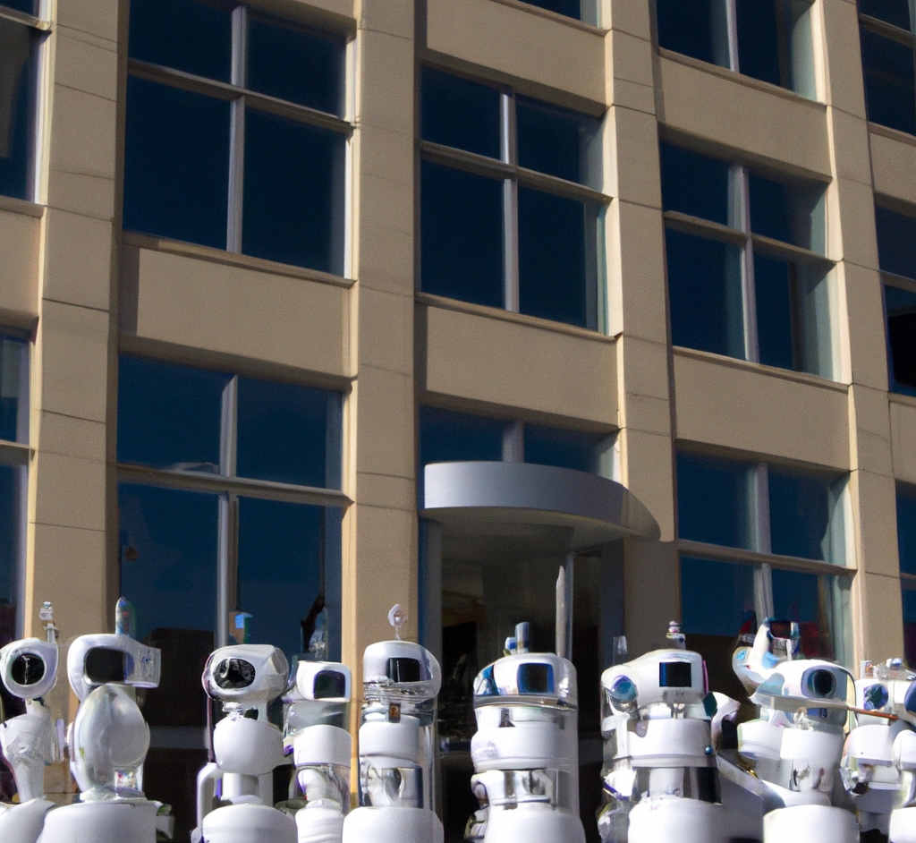
“a swarm of telepresence robots takes over an office building”
DALL·E 2

Slide 46
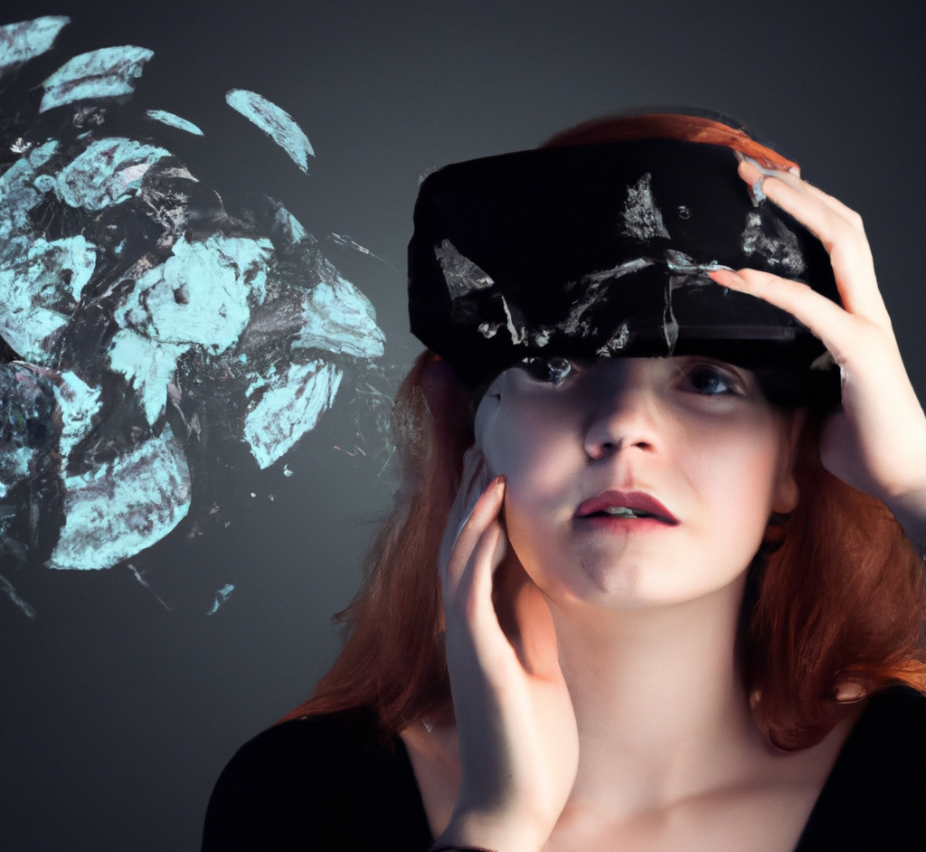
“A girl wears an augmented reality headset and imagines a layer of information covering every surface”
DALL·E 2

Slide 47
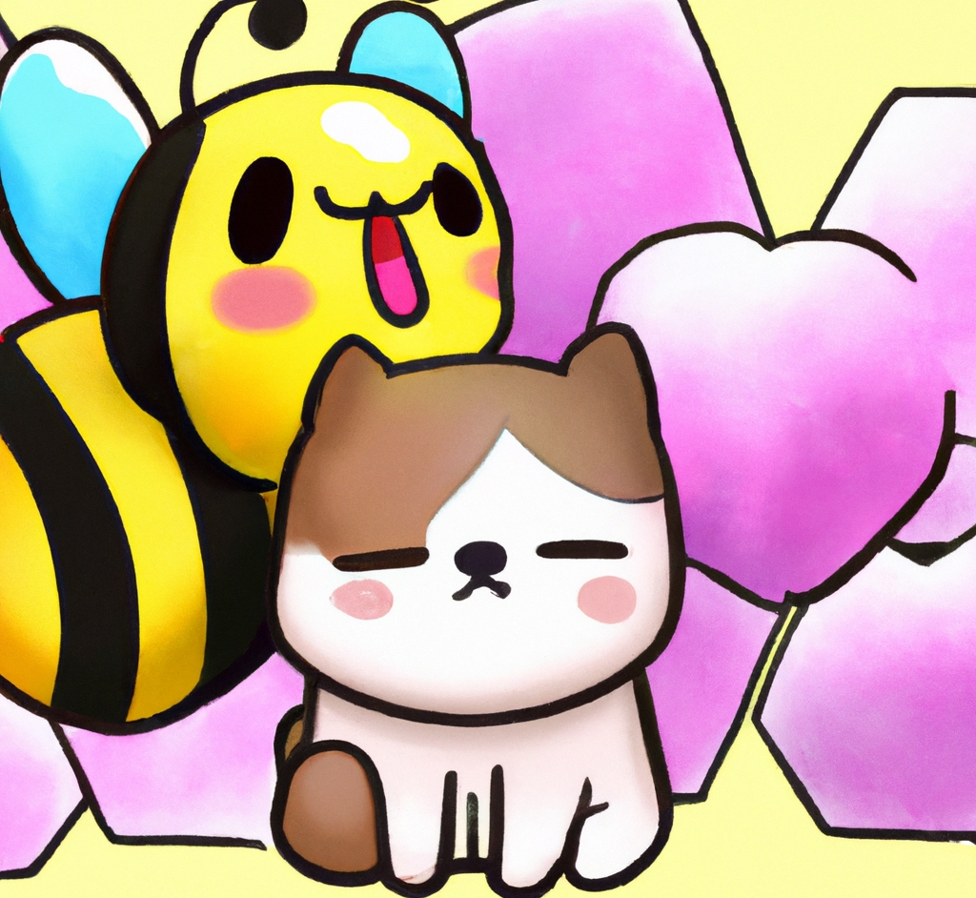
“Bee and puppycat”
DALL·E 2

Slide 48
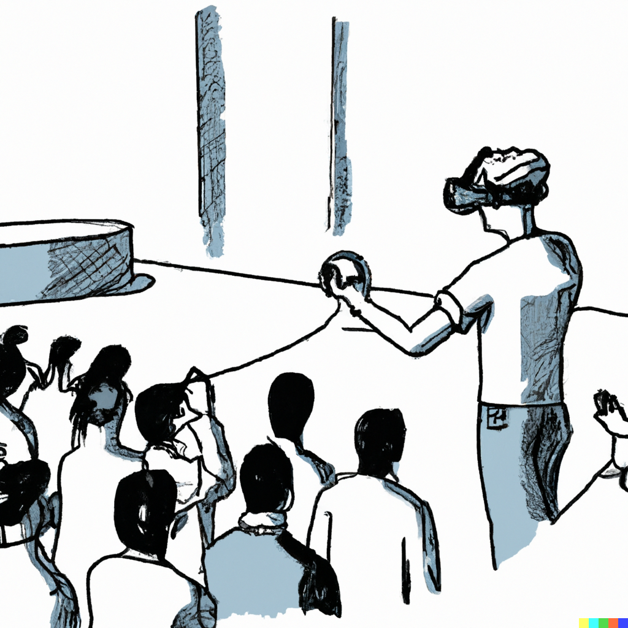
“A person practices giving a presentation in virtual reality, line art.
DALL·E 2

Slide 49
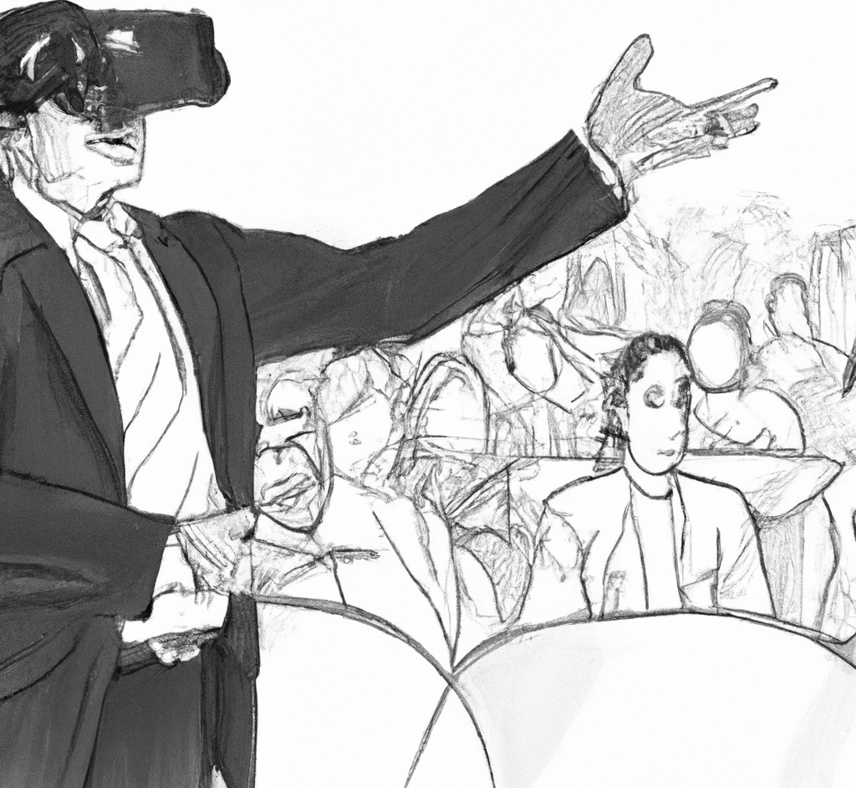
“A person practices giving a presentation in virtual reality, line art.
DALL·E 2

Slide 50
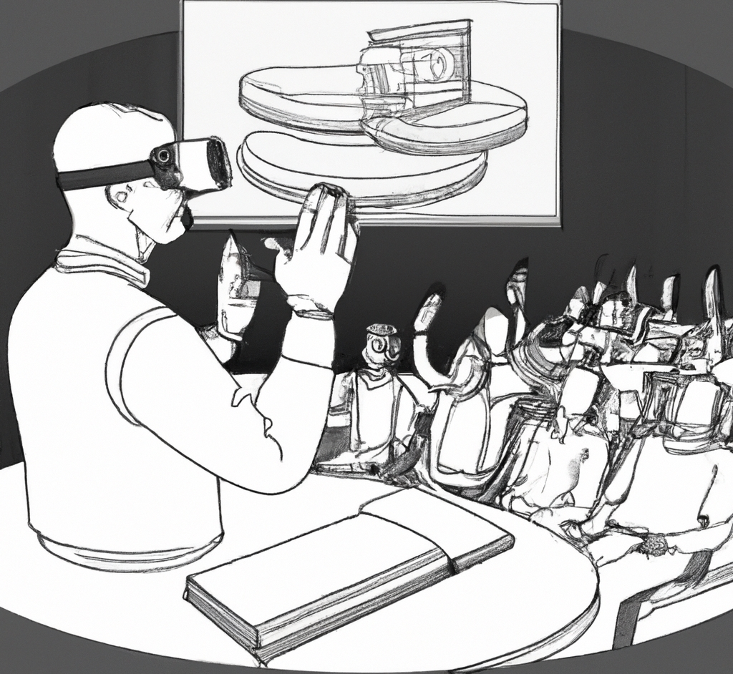
“A person practices giving a presentation in virtual reality, line art.
DALL·E 2

Slide 51
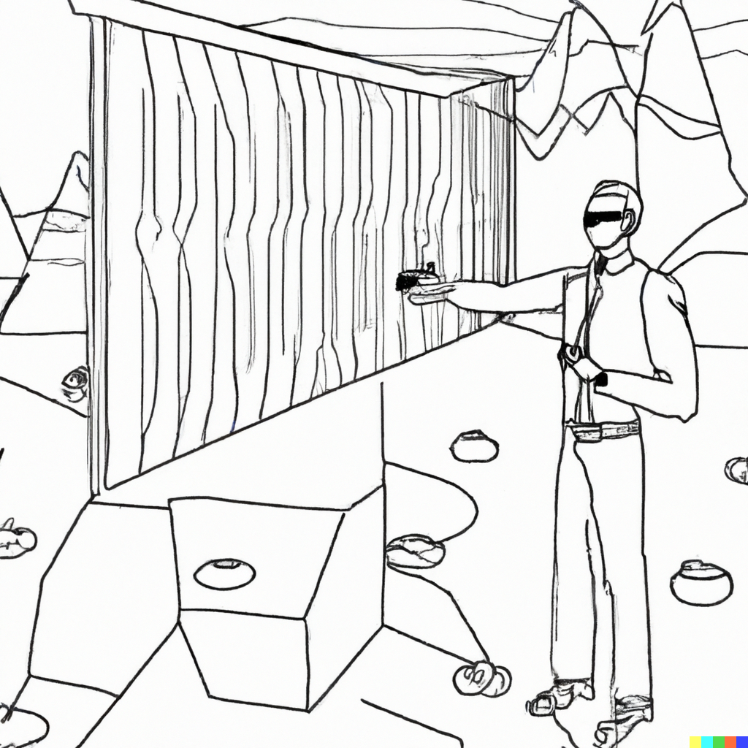
“Giving a presentation in a VR wonderland, line art”
DALL·E 2

Slide 52

“Giving a presentation in a digital wonderland, line art”
DALL·E 2

Slide 53

“line art”
DALL·E 2

Slide 54

“line art”
DALL·E 2

Slide 55

“line art”
DALL·E 2

Slide 56

“line art”
DALL·E 2

Slide 57

“line art of a spooky skeleton wearing a backwards baseball cap and sunglasses”
DALL·E 2

Slide 58

“Mickey Mouse jack-o’-lantern”
DALL·E 2

Slide 59

“Mickey Mouse jack-o’-lantern”
DALL·E 2

Slide 60

“Mickey Mouse jack-o’-lantern”
DALL·E 2

Slide 61

“secret santa”
DALL·E 2

Slide 62

“secret santa”
DALL·E 2

Slide 63

“secret santa”
DALL·E 2

Slide 64

“santa claus in a black trenchcoat and sunglasses, digital art”
DALL·E 2

Slide 65

“half of a bagel, 3d render”
DALL·E 2

Slide 66

“half of a bagel, 3d render”
DALL·E 2

Slide 67

“half of a bagel surrounded by a 3d bounding box with arrows pointing in the x, y, and z axes, 3d render”
DALL·E 2

Slide 68

“a single bagel is levitating above an outstretched palm, line art”
DALL·E 2

Slide 69

“a single bagel is levitating above an outstretched palm, line art”
DALL·E 2

Slide 70

“LandLand: a theme park where all the exhibits are of land animals.”
DALL·E 2

Slide 71

“LandLand: a theme park where all the exhibits are of land animals.”
DALL·E 2

Slide 72

“LandLand: a theme park where all the exhibits are of land animals.”
DALL·E 2

Slide 73

“LandLand: a theme park where all the exhibits are of land animals. Gothic oil painting.”
DALL·E 2

Slide 74

“LandLand: a theme park where all the exhibits are of land animals. Gothic oil painting.”
DALL·E 2

Slide 75

“LandLand: a run down theme park where all the exhibits are of land animals. There are roller coasters and animals are dressed as clowns. The children look lost.”
DALL·E 2

Slide 76

“LandLand: a run down theme park where all the exhibits are of land animals. There are roller coasters and animals are dressed as clowns. The children look lost.”
DALL·E 2

Slide 77

“LandLand: a run down theme park where all the exhibits are of land animals. There are roller coasters and animals are dressed as clowns. The children look lost.”
DALL·E 2

Slide 78

“an ad for an iPhone from 1922, newspaper print scan”
DALL·E 2

Slide 79

“an ad for an iPhone from 1922, newspaper print scan”
DALL·E 2

Slide 80

“machine learning, psychedelic synthwave art”
DALL·E 2

Slide 81

“corgi wearing a beret, synthwave”
DALL·E 2

Slide 82

“cat, synthwave aesthetic”
DALL·E 2

Slide 83
The possibilities are endless. Let’s see a live demo.

